Slide 1
Interacting and Connecting in a Pluralistic World
@MuslimsInBritRN, #STEP
Nicole Brown
@ncjbrown
www.nicole-brown.co.uk

Slide 2
Interacting and Connecting in a Pluralistic World
@MuslimsInBritRN, #STEP
Nicole Brown
@ncjbrown
www.nicole-brown.co.uk
Notes:
Secondary Teacher Education Programme
How the STEP programme encourages students to engage in scholarly debates around Muslim identity
STEP programme designed for and is aimed at Ismaili Muslims

Slide 3
UCL IOE logo retrieved from: https://www.ioe.ac.uk/about/48697.html
IIS logo retrieved from: http://www.iis.ac.uk/
Notes:
STEP is jointly delivered between the UCL Institute of Education and the Institute of Ismaili Studies
Post-graduate teacher education for Ismaili Muslims from around the world
A double Master's degree.
MA Education (Muslim Societies and Civilisations) and Master of Teaching (MTeach).

Slide 4
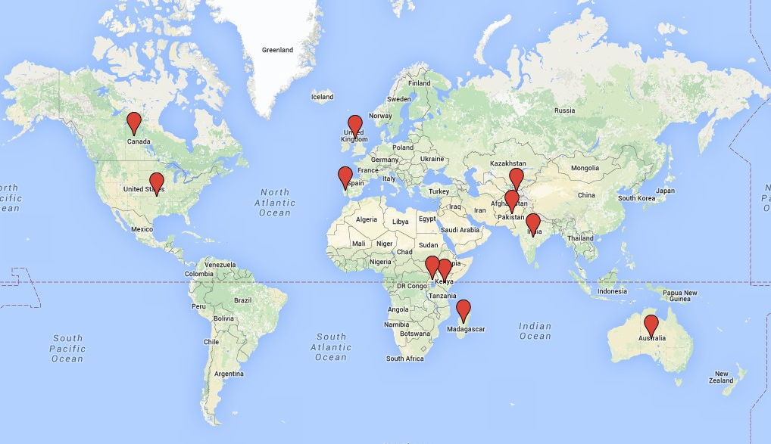
Map created at https://maps.google.co.uk
Notes:
Students from Ismaili communities around the world: Canada, the United States, the United Kingdom, Kenya, Portugal, Madagascar, Pakistan, India, Tajikistan and Australia.
Work as STEP teachers within voluntary faith schools in religious centres.

Slide 5
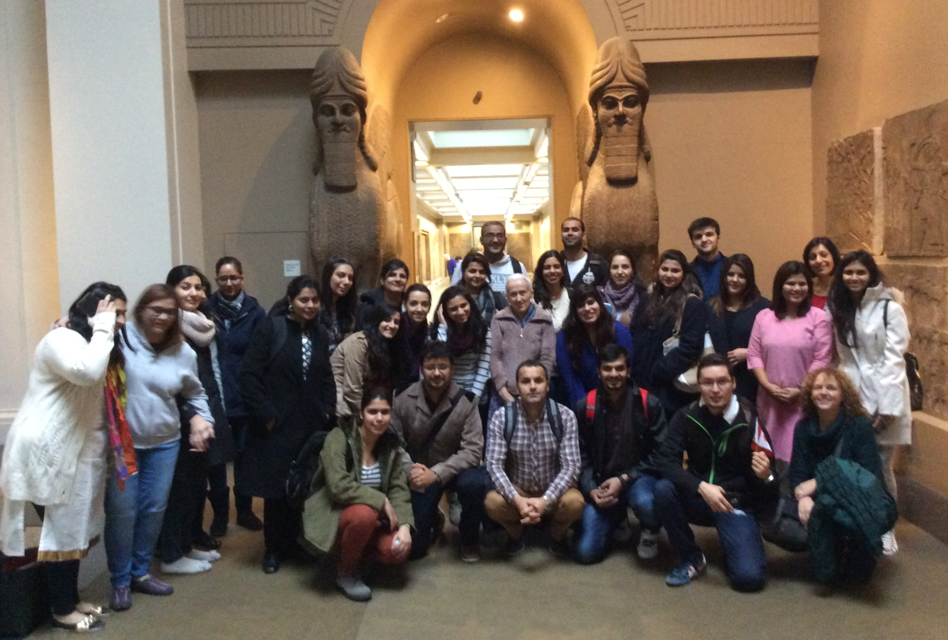
Notes:
active engagement with the pluralistic dimensions of the Ismaili Muslim identity

Slide 6
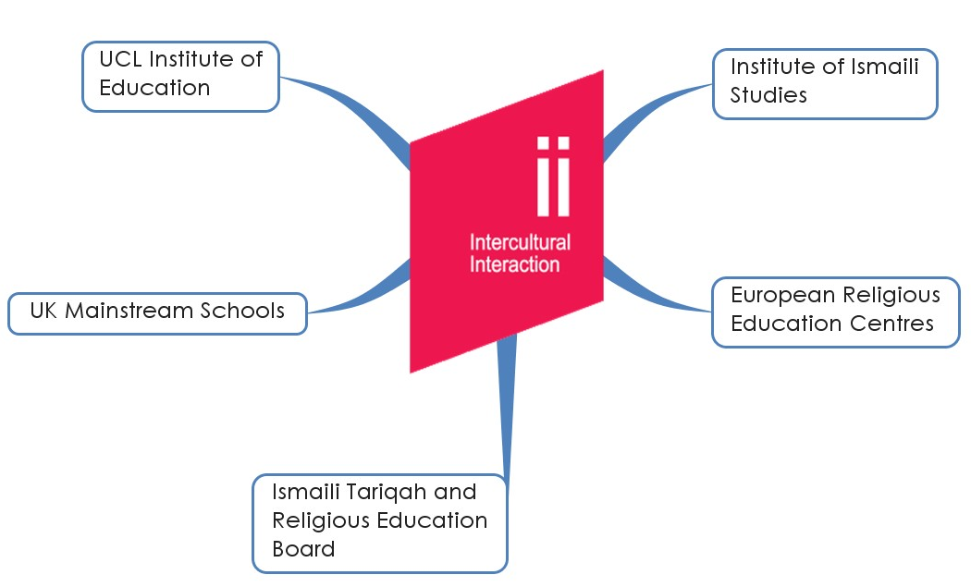
Intercultural Interaction logo retrieved from https://www.ucl.ac.uk/intercultural-interaction
Notes:
Societal and social diversity have increased, and interactions have also intensified
Placements in UK mainstream schools and in religious centres in Europe as well as the students’ home countries

Slide 7
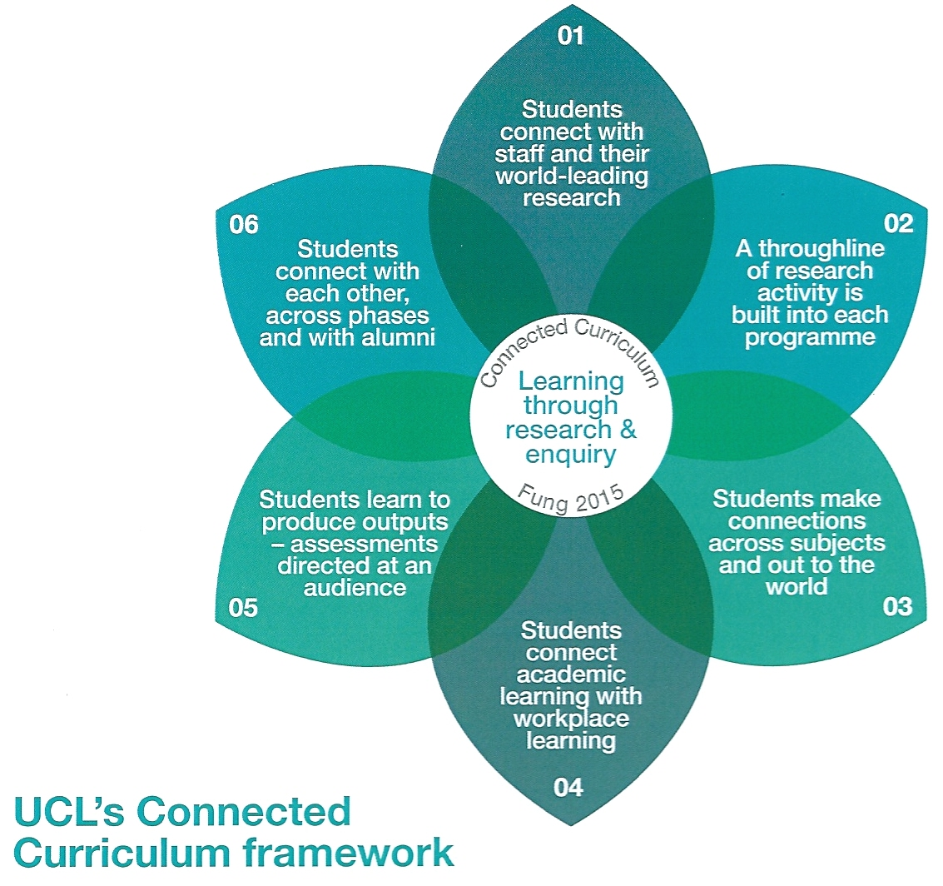
Connected Curriculum logo retrieved from https://www.ucl.ac.uk/teaching-learning/connected-curriculum/learn-more
Notes:
STEP is at the forefront of UCL’s Connected Curriculum, a framework that is designed to focus on research-based education. By embedding the UCL Connected Curriculum within STEP students’ engagement with the Muslim historical narratives results in a nuanced understanding of the diverse and pluralistic discourse of Islamic religion and civilisations.

Slide 8
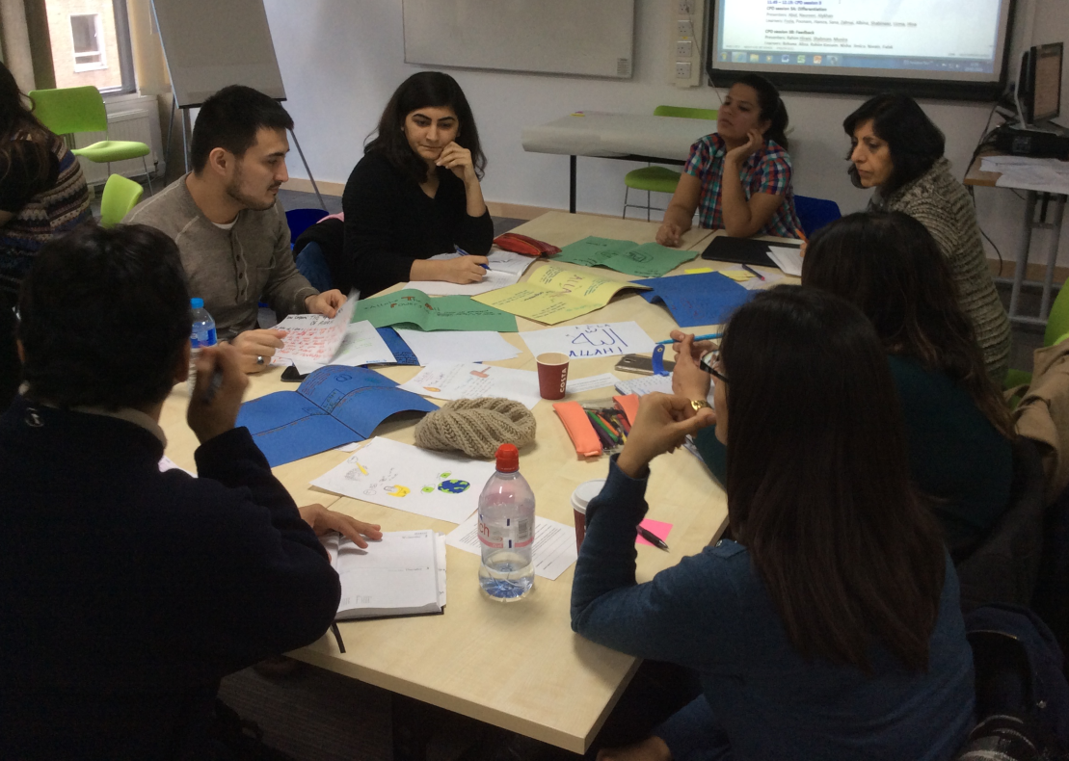
Notes:
Group work is set up so that students from a range of countries exchange their ideas.

Slide 9
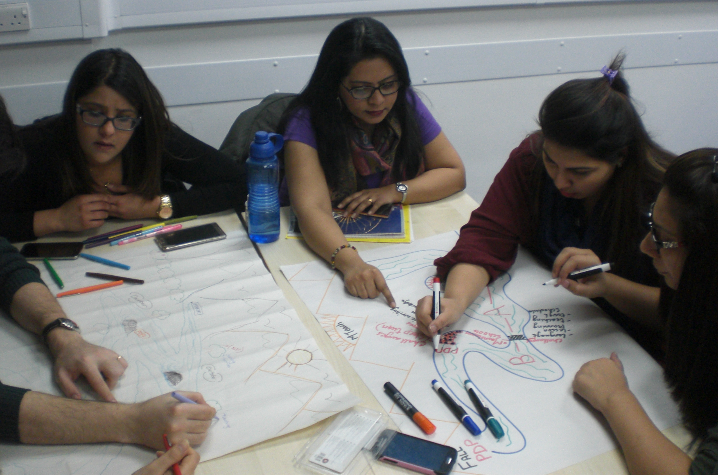
Notes:
This is a picture of MTeach work in Year 1 of the programme, where such connections and links are exemplified.

Slide 10
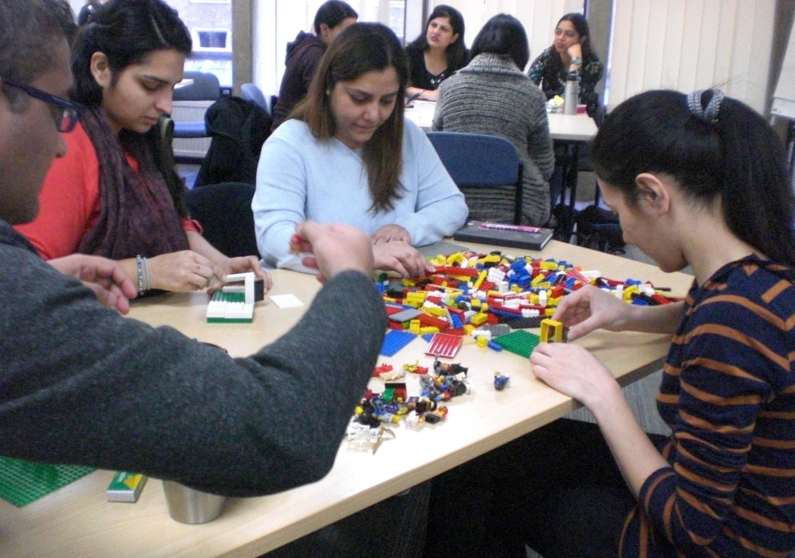
Notes:
Instead of drawing a river some students are asked to build a Lego model to reflect on their learning.

Slide 11
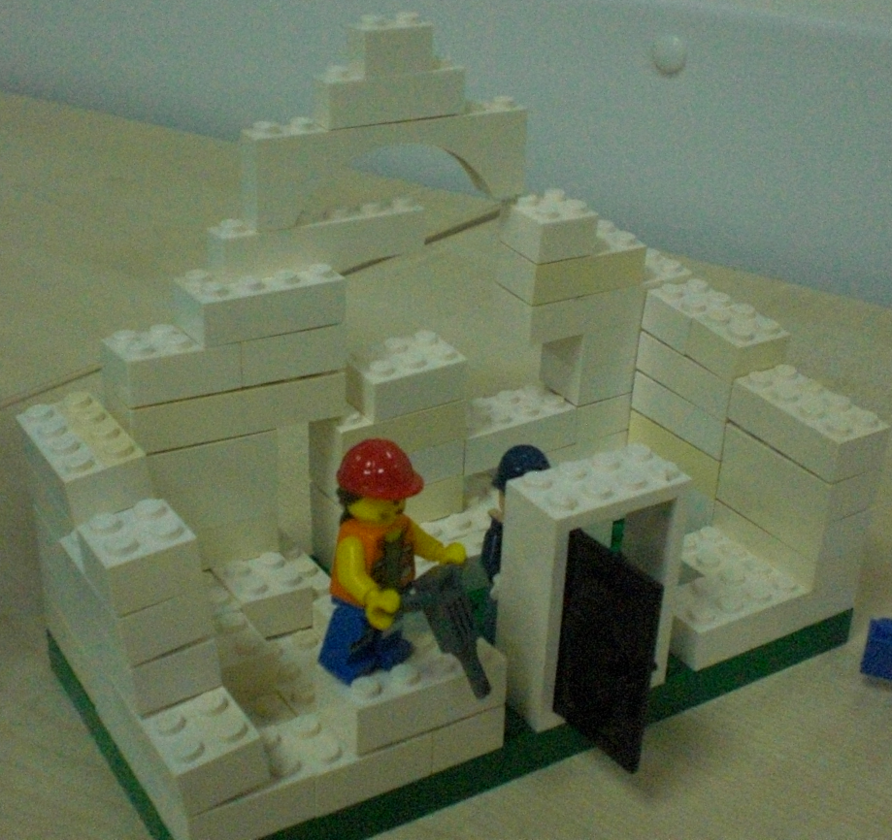
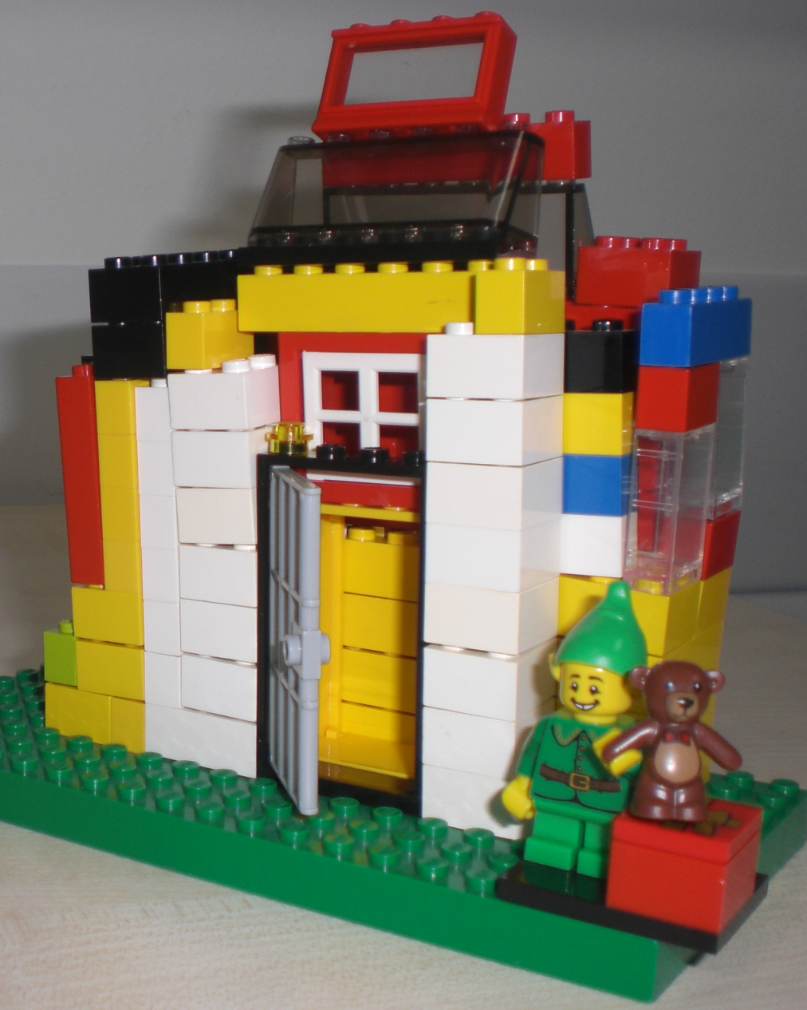
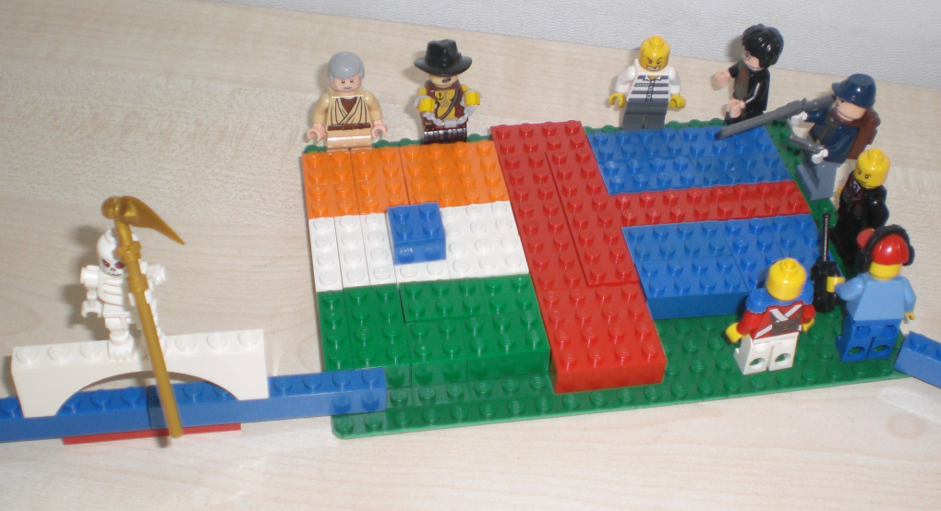
Notes:
Here is one example of such a learning journey.

Slide 12
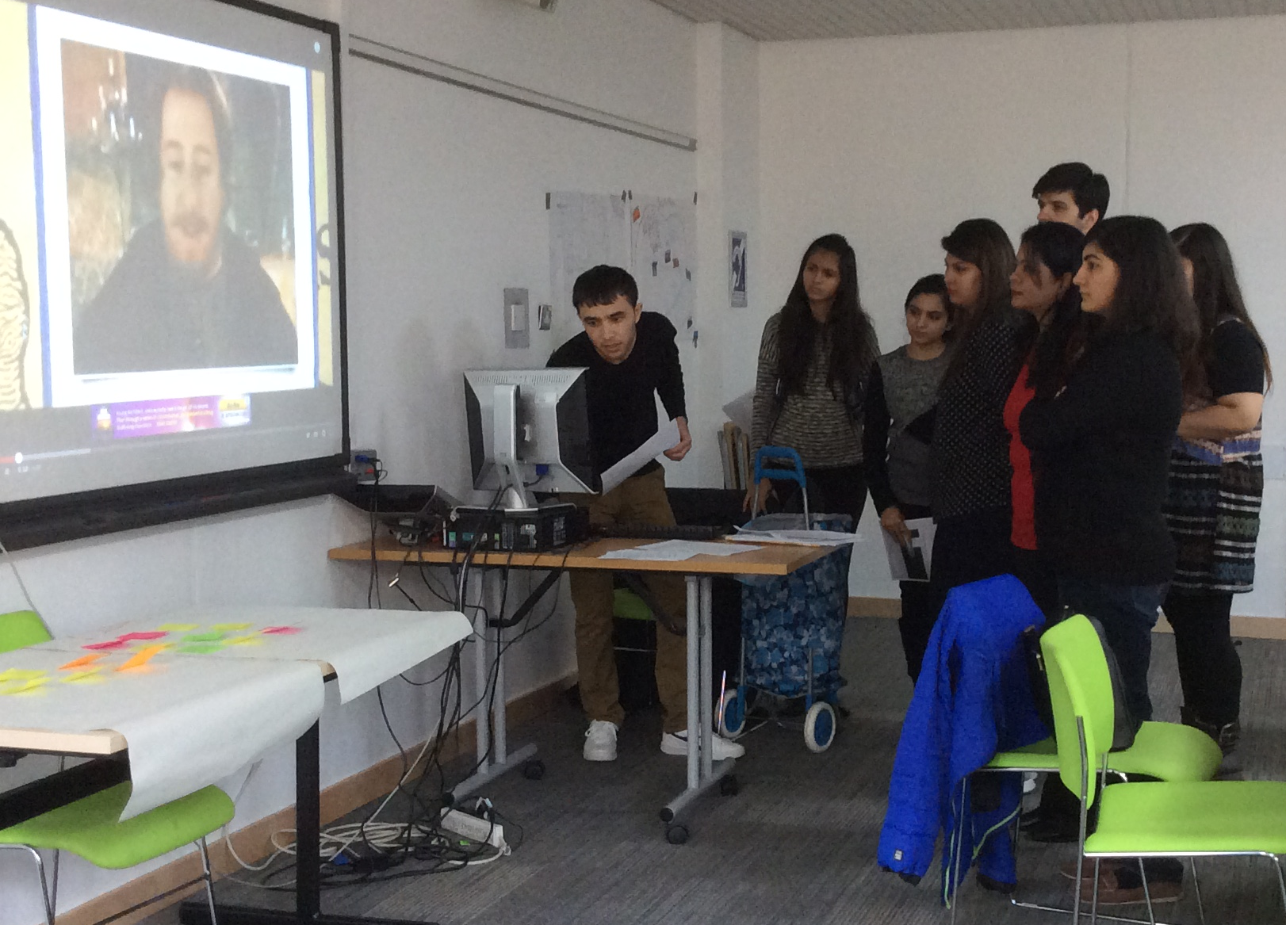
Notes:
Muslim history from the dawn of Islam to the fall of the Ottoman Empire
Students explore the links between their course content and the curriculum they teach

Slide 13
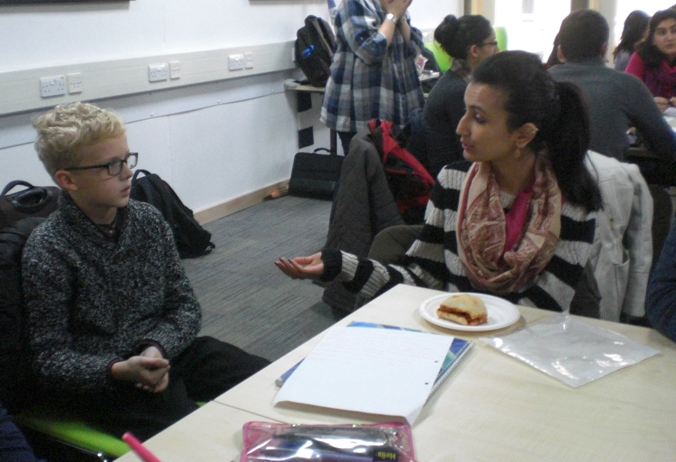
Notes:
In order to be able to make connections out to the world, sometimes it is necessary to bring the world in.

Slide 14
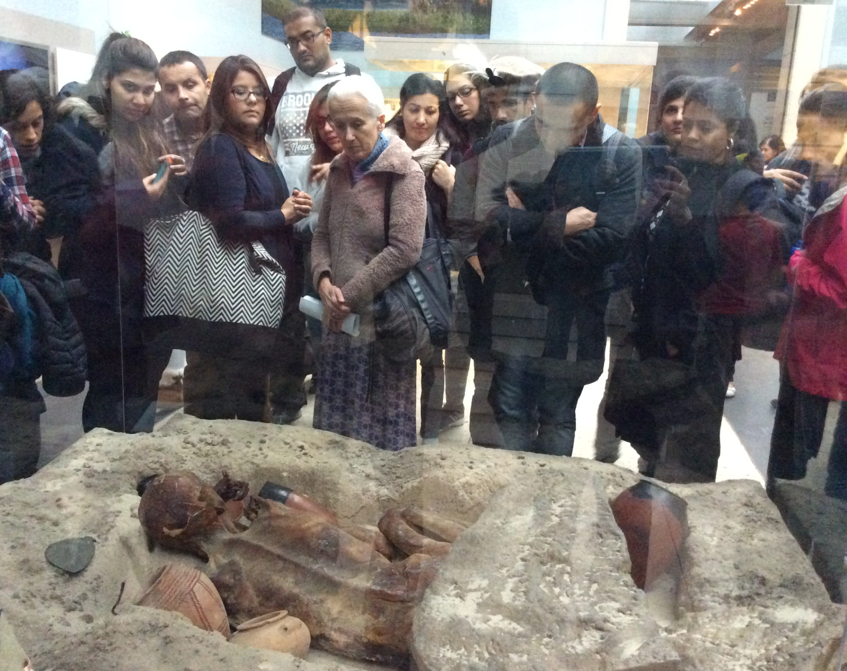
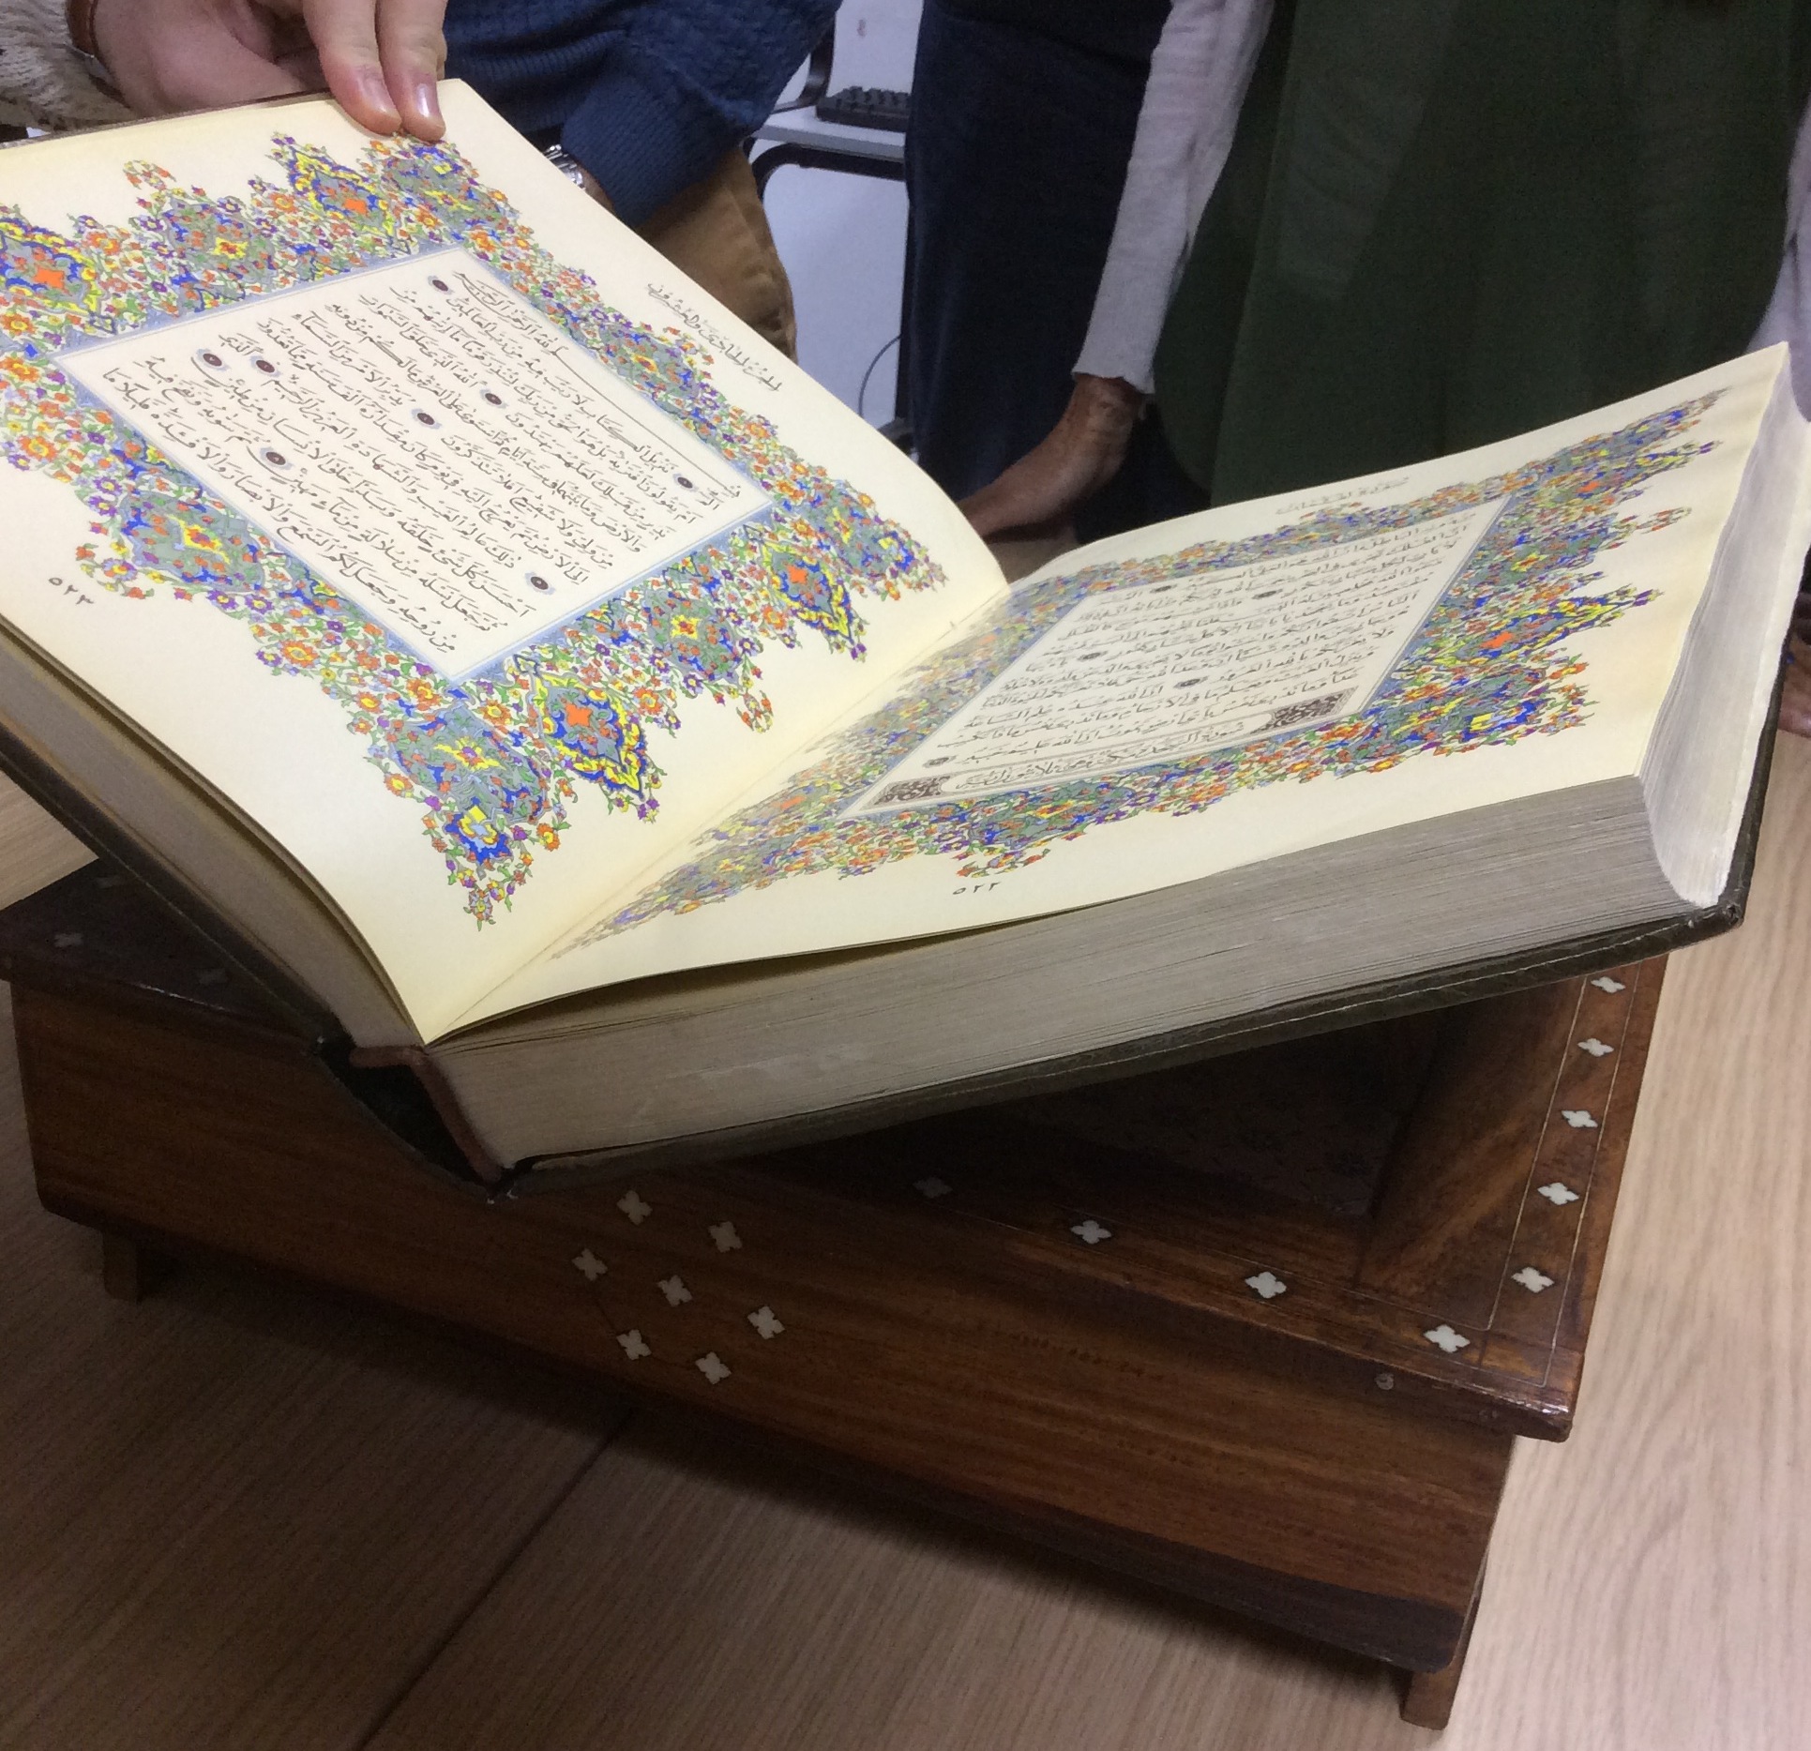
Notes:
Field trips within the UK and to Spain

Slide 15
Slide from Munira RAMANI
Slide from Hina AMIRALI
Slide from Naseer AHMADI
Notes:
STEP also provides students with opportunities to engage in discussions relating to their identities and contexts

Slide 16
Research modules
MA report module
MTeach RPP and PBE
Connected Curriculum logo retrieved from https://www.ucl.ac.uk/teaching-learning/connected-curriculum/learn-more
Notes:
Towards the end of the first year and throughout the second year of the STEP programme in particular we foster the students' engagement with research by teaching skills to read critically and by developing students' research literacy in theory and practice, thus strands 2 and 5.

Slide 17
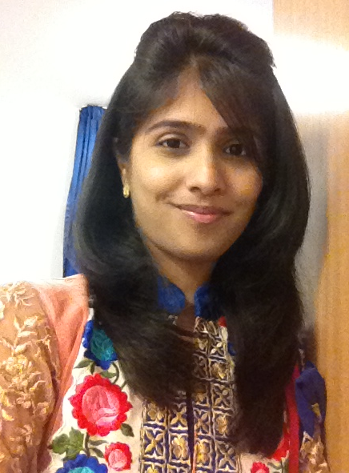
Exploring Notions of Diversity and Pluralism through the Muslim Societies and Civilisations Module in an Ismaili RE Classroom in Mumbai, India
Sana Kabira
Cohort 7
Notes:
During her first year of the STEP programme Sana was introduced to the complexities of the diversity within Muslim societies, and she felt that her own learners should be exposed to and learn about these, too, so she investigated this topic to provide a knowledge base for teachers in her context. For example, Sana’s findings indicate that pupils struggle to distinguish diversity from pluralism and that it is the teacher’s responsibility to help pupils make meaning of these concepts.

Slide 18
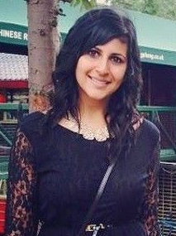
The Power of Music: an Exploration into the Use of Background Music in the Religious Education Classroom to Enhance Classroom Environment
Karina Hussein
Cohort 6
Notes:
Karina had observed that in Canada music played an important role within the mainstream schools to engage pupils and she wanted to find out whether this increased engagement could be replicated within voluntary lessons. Karina found that music had a huge impact on pupils’ ability to recall information in addition to helping to render a relaxed environment conducive to learning. Karina shared her research on the MTeach online journal, and will be presenting a paper at a Conference in Canada later this year.

Slide 19
UCL IOE logo retrieved from: https://www.ioe.ac.uk/about/48697.html
IIS logo retrieved from: http://www.iis.ac.uk/
Notes:
Integration and connection means close and consistent
Working groups, such as the academic writing group, the integration group, an enrichment group.

Slide 20
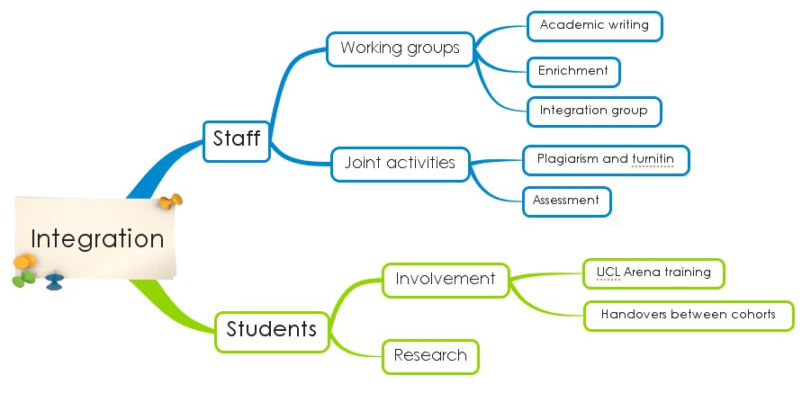
Notes:
So where does this take us now?
A research project about the students’ perception relating to the effectiveness of UK mainstream

Slide 21
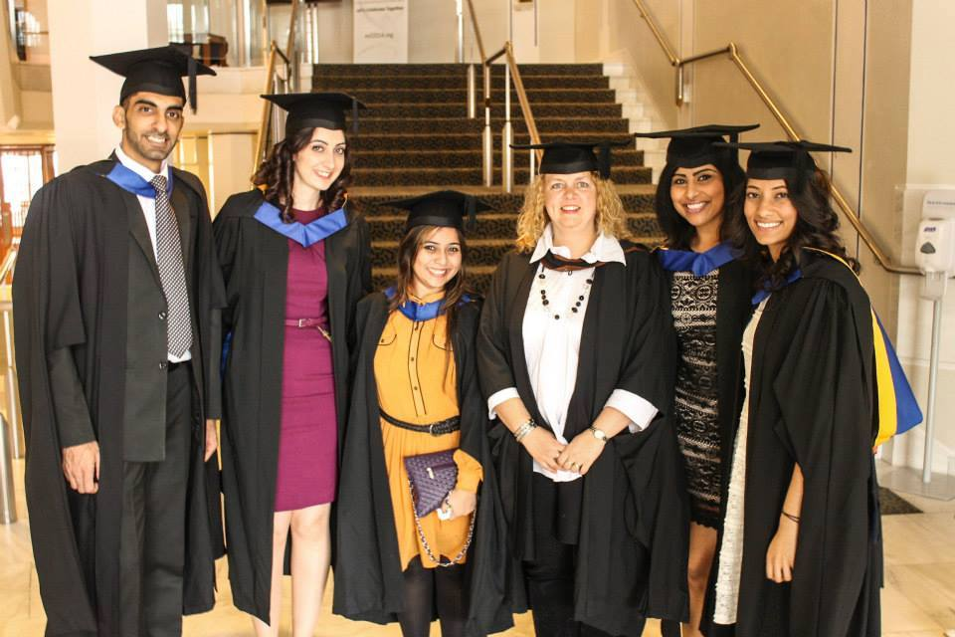
Interacting and Connecting in a Pluralistic World
Nicole Brown
@ncjbrown
www.nicole-brown.co.uk
@MuslimsInBritRN, #STEP
Notes:
STEP is exemplary in fostering critical thinking and engagement with research

