Slide 1
Partnership for Learning
collaboration between staff and students to develop innovative approaches to teaching and learning
Nicole Brown
@ncjbrown
www.nicole-brown.co.uk
#STEPTL

Slide 2
Outline
Sense of ownership and belonging in the STEP context
Student voice and involvement
Developing strategies in staff-student collaboration
Learning together
Benefits and challenges
Key points
Notes:
A brief summary of what I will be covering in my presentation.

Slide 3
Sense of ownership and belonging
in the STEP context
Literature: safe haven where learning occurs (Quinn 2005)
identification and belonging before entering University (Read, Archer and Leathwood 2003)
experience of own learning identity before entering University (Christie et al. 2008)
Practice: staff and students play many roles
belonging to two institutions
modular approach (Goldschmid and Goldschmid 1973, Morrison 1996)
Notes:
Students' sense of belonging to a university or community of practice and the necessity of such sense of belonging for student engagement and retention have been investigated in a range of studies (see Christie et al. 2008; Quinn 2005; Read, Archer, and Leathwood 2003; Thomas 2012). In their article about a longitudinal study on learning and learning experiences at the transitional phase of entering university Christie et al. (2008) highlight that the sense of belonging at universities is strongly related to the status of students' initial learning identity and how secure students felt in their learning identity before entering university. Referring to two studies with women students Quinn (2005) discovered that for the students interviewed university was not so much a community of practice as a safe haven, where learning occurs and ideas materialise, or at a more symbolic and imaginary level, where strangers are together. Read, Archer, and Leathwood (2003) investigated sense of belonging by considering the difference between traditional and non-traditional students. Their findings demonstrate that identification with universities and communities of practice often commences before students even enter their chosen university. The authors highlight that sense of belonging and community spirit continue to be developed within academic activities and as part of non-academic life on campus. Atypical or non-traditional students, such as mature students, may not actively take part in traditional student life, which results in the students feeling different and isolated. Navigating university life, developing a sense of belonging and becoming part of a community of practice therefore seem difficult enough at the best of times for many students. But within a project, where a programme is delivered across two institutes and two teaching placements students' sense of belonging may become even more fragmented.
STEP students have many roles to play: they are trainee teachers in UK mainstream schools, they work as co-teachers in religious education centres, they are students at the Institute of Ismaili Studies and they are students at the UCL Institute of Education. STEP students spend their time in such a variety of different working environments whilst at the same time living in accommodation, where they share communal spaces with their peers from all over the world. Of course, the benefits of such rich experiences are immeasurable, but at the same time there could be a risk of students feeling lost and becoming unsettled. In order to counteract such issues all stakeholders, lecturers, administrators, tutors, teachers and mentors from schools and religious education centres regularly reinforce STEP as a community of practice with students not necessarily belonging to the IIS or UCL IOE, but to STEP and identifying as STEP students and eventually STEP teachers. STEP students are encouraged to engage in the wider community of academics within the Institute of Ismaili Studies as well as within the UCL Institute of Education and indeed the University College of London as a whole. However, the STEP family of current and past cohorts of students is seen as the primary support network and learning community.
As has been touched upon already, tutors and lecturers play an important role where students' sense of belonging and communities of practice are concerned. However, the full extent of the tutors' and lecturers' roles becomes more apparent when considering the knowledge transmission of the programme. Goldschmid and Goldschmid (1973) and later Morrison (1996), for example, discuss how the modular approach to teaching within higher education leads to a fragmented experience of learning for students. The authors acknowledge the benefits of modular instruction such as that learning is broken down into more manageable entities and that learning can become more personalised and meaningful if there are choices of modules. At the same time, however, these advantages could become pitfalls for students who fail to make links between modules and connect the learning from a variety of modules to lead to one cohesive programmatic structure. If the modular approach within higher education is experienced as fragmented what does that mean for a programme where there are so many separate strands? These strands need to be brought together and it is primarily the lecturers' and tutors' role to help students make those connections. This is only possible if the communication between the partner institutes is structured but free from constraints, in line with the individual institute's policies, but also aligned with the overall aims of the programme, regular, but also responding to specific needs and unforeseen circumstances. All lecturers and tutors need to be aware of the contents taught in the two degree courses so that meaningful cross-references can be made, irrelevant duplication can be avoided and instead knowledge from all modules can be built upon. Although the students are studying for two separate master's courses, the MA Education (Muslim Societies and Civilisations) and the Master of Teaching, the programme is set out and linked in such a way that it is considered as one programme, STEP. Collaboration within STEP is therefore more than merely staff of two institutes working together; collaboration within STEP is synonymous with integration. The level of integration of the two courses, the separate strands of enrichment classes and the teaching placements in the mainstream schools as well as the religious education centres is a particular strength of STEP. And tutors and lecturers are a driving force for integration, streamlining support and managing students' expectations across the institutes.

Slide 4
Student voice and involvement
Principles: students control their learning and environment
better learning
Surveys: National Student Survey
Postgraduate Experience Surveys
to give feedback about learning, teaching and other aspects of courses
to contribute to public accountability
to inform the choices of prospective students
to enhance student experience
Initiatives: Connected Curriculum at UCL
Notes:
In the current climate within higher education student voice plays a crucial role regarding the development and modification of learning environments and courses, and is used for quality assurance and performance assessment purposes, as well as to shape the student experience (see Grebennikov and Shah 2013; Frankham 2015). As with other programmes the STEP programme, too, uses surveys and student feedback forms to inform changes to module contents and deliveries with the aim to improve student experience and develop students' learning further. However, within the STEP programme the students play another, more important role. Truly, the students are the only stakeholders within STEP that see and experience all aspects and strands of the programme. As has been said, lecturers can help make the links from one institute to the other, but it is the students who experience those links and can therefore evaluate the effectiveness of such connections. In a way, therefore, the students act as intra- and inter-institutional mediators, thereby shaping the programme considerably. Within the scope of the National Student Survey students may refer to their experiences of challenging materials and assignments (Frankham 2015), and may therefore have an indirect impact in that lecturers review and revise their reading lists. However, the students on the STEP programme take a more active role by accepting responsibility for their own learning. Where enrichment sessions are concerned, for example, students get involved in action research that is developed in collaboration and partnership with academic staff. The participatory nature of such collaborative work results in the students taking ownership of certain elements of the course, which in turn leads to improved engagement with and experiences of the programme. Although such partnership projects are being promoted and have become more influential across universities in recent years (see Bovill, Cook-Sather, and Felten 2011; Cook-Sather, Bovill, and Felten 2014; Dickerson, Jarvis, and Stockwell, 2016), the STEP programme has always fostered such engagement from its students. The main difference of STEP to many other programmes lies in the circumstances of the studentship. Not only are they international students, they agree to be uprooted and removed from their home contexts, their families and friends for two years to study on this programme, which is probably why the students are particularly keen to make the experience worthwhile for themselves but also for those that come after them.

Slide 5
Learning together
inter-institutional staff training
web-based audience response systems
modelling
cross-curricular involvement
developing new approaches to teaching with students
river reflection
LEGO®
staff-student research

Slide 6
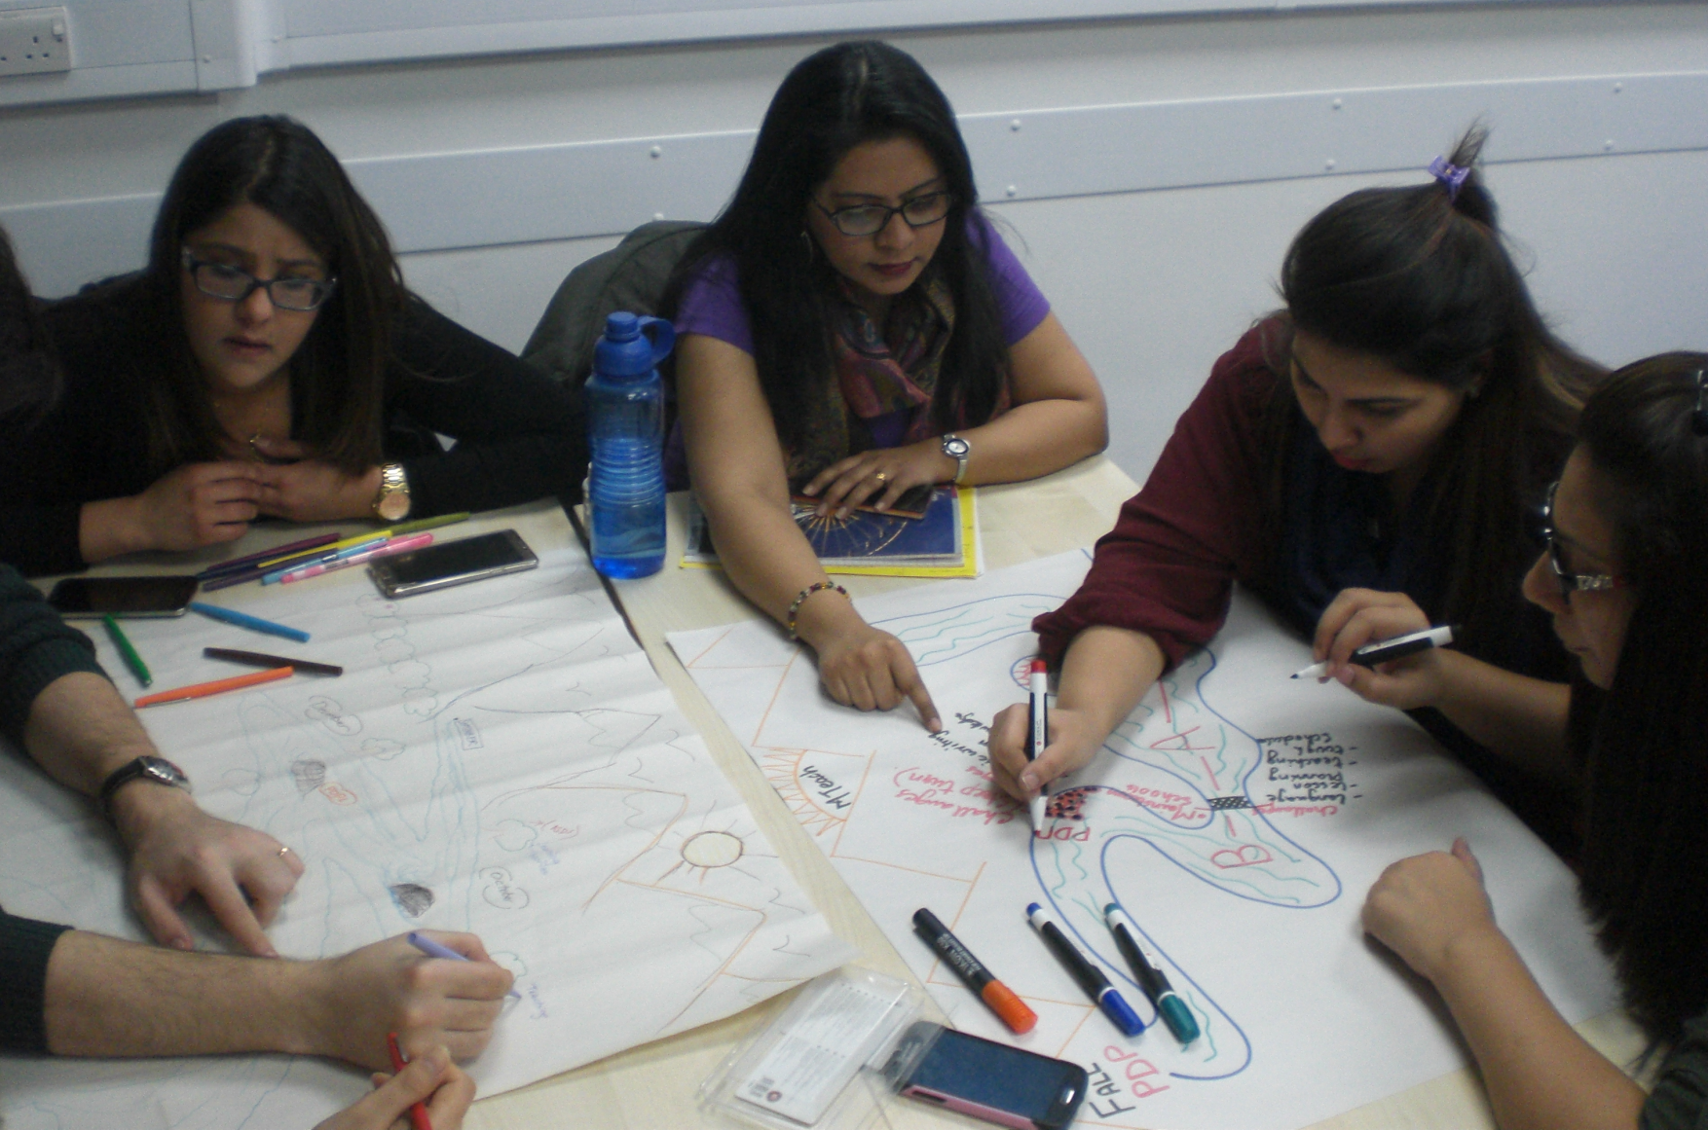
Notes:
Presentation and explanation of the river reflection task.
Development from usual reflections to reflections that go deeper.
This is an example of MTeach work in Year 1 of the programme.
Using a model of reflection students are asked to depict their journey throughout the STEP programme as a river from source to mouth. The emphasis lies on connecting the contents of both the MA and MTeach work.

Slide 7
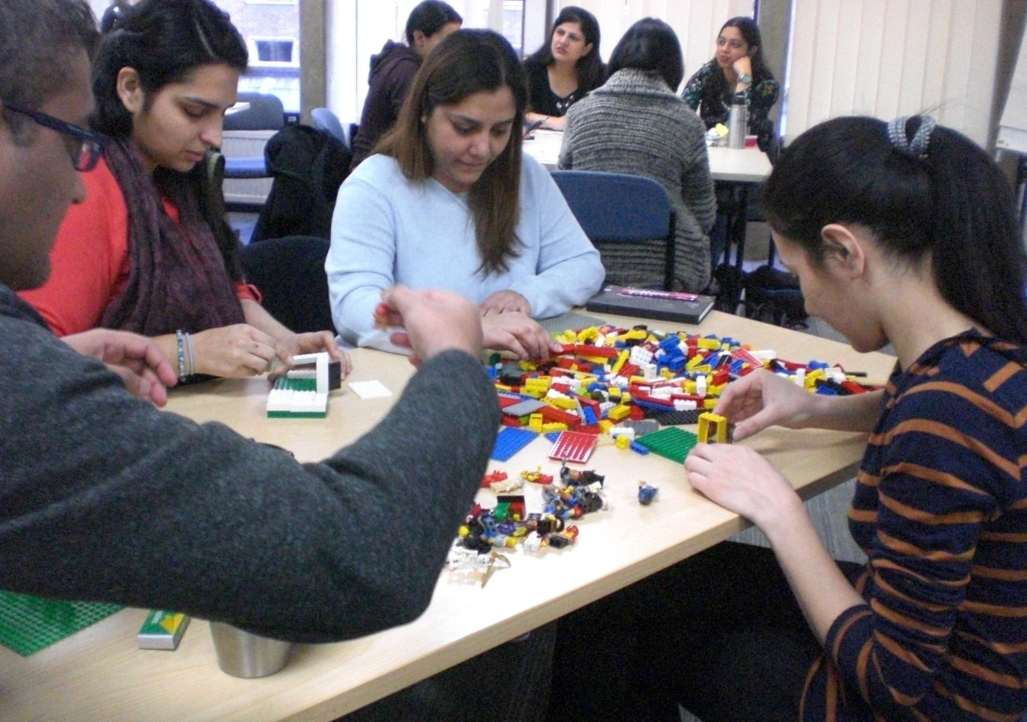
Notes:
Instead of drawing a river some students are asked to build a Lego model to reflect on their learning. The students are supplied with a range of old-fashioned, coloured bricks, some extra features, like windows, doors and arches, as well as with some LEGO people.

Slide 8
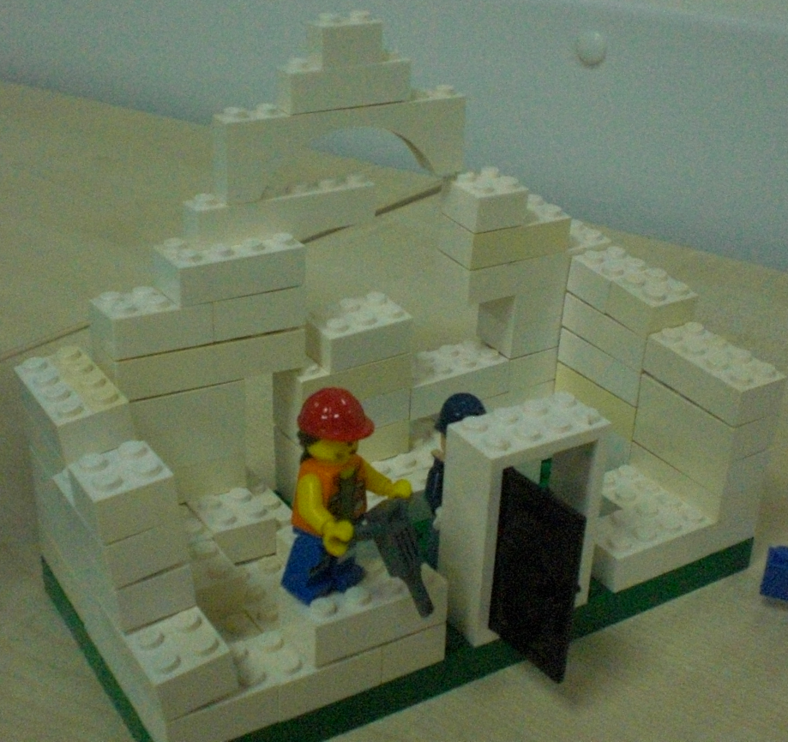
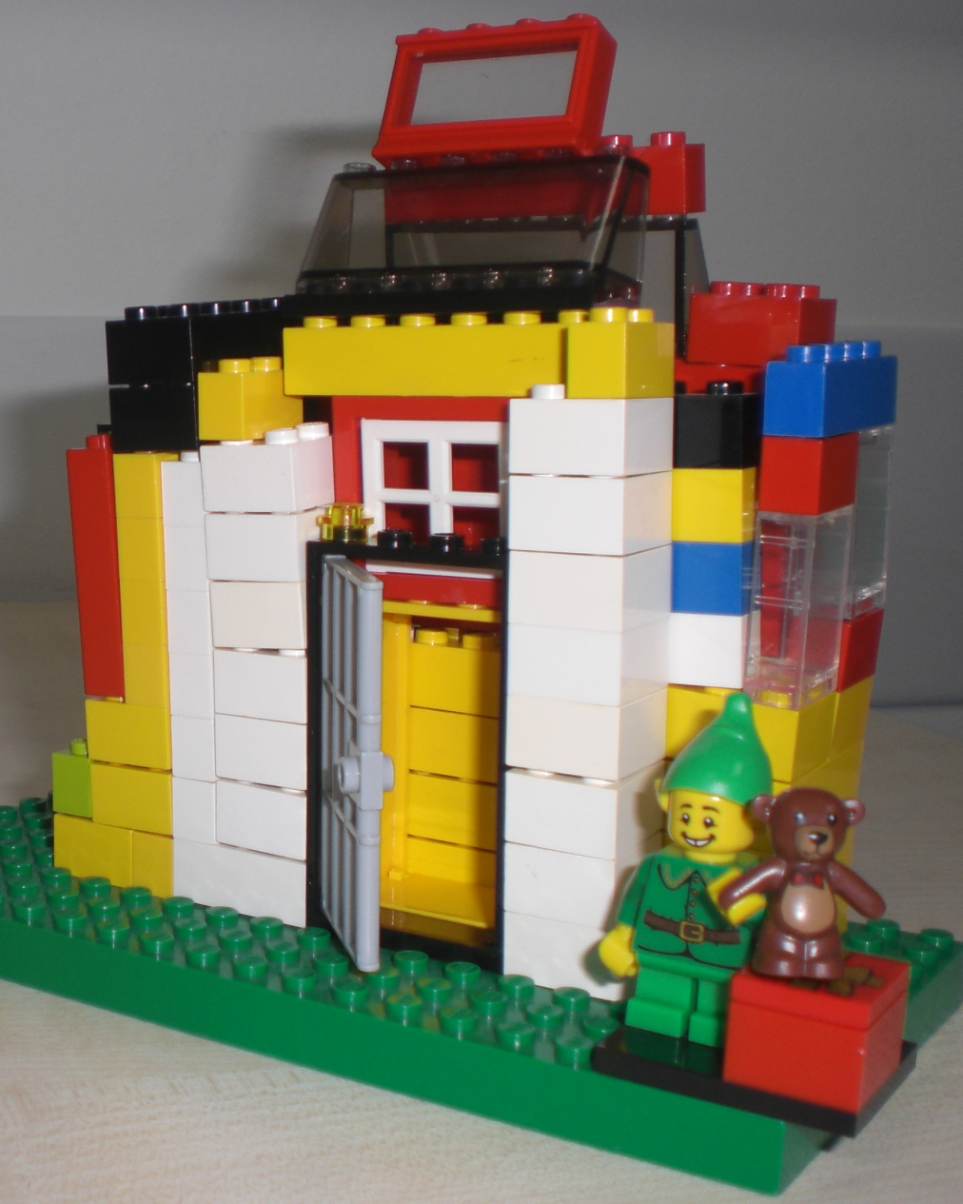
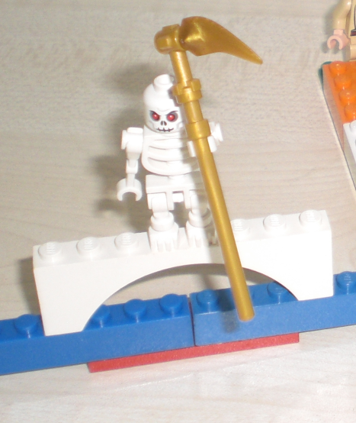
Notes:
Here is an example of such a learning journey. The buildings demonstrate how the students‘ understanding of effective learning has changed over the course of the first term. Where learning was seen as rigid and structured initially, it is now considered as multifaceted with many opportunities. The skeleton indicates challenges the students experienced.
The first building with the white bricks demonstrates that the students had had some understanding relating to effective learning, but with bricks being white only shows that the students’ understanding was rigid, structured and situated within their personal backgrounds. But students were looking forward to their learning journey, so there is the door to the next part.
Over the course of the first term, students have started to understand that effective learning is more complex, which is symbolised in the building on right. A building that now has more windows and doors, and is made of many different colours. The Christmas elf is used to acknowledge the importance of pupils’ voice and needs and the learning that any teaching needs to be aligned to and driven by pupils.
The skeleton indicates challenges the students experienced. For some these challenges were of a practical nature, for others the difficulties related to their philosophies and outlooks being challenged.

Slide 9
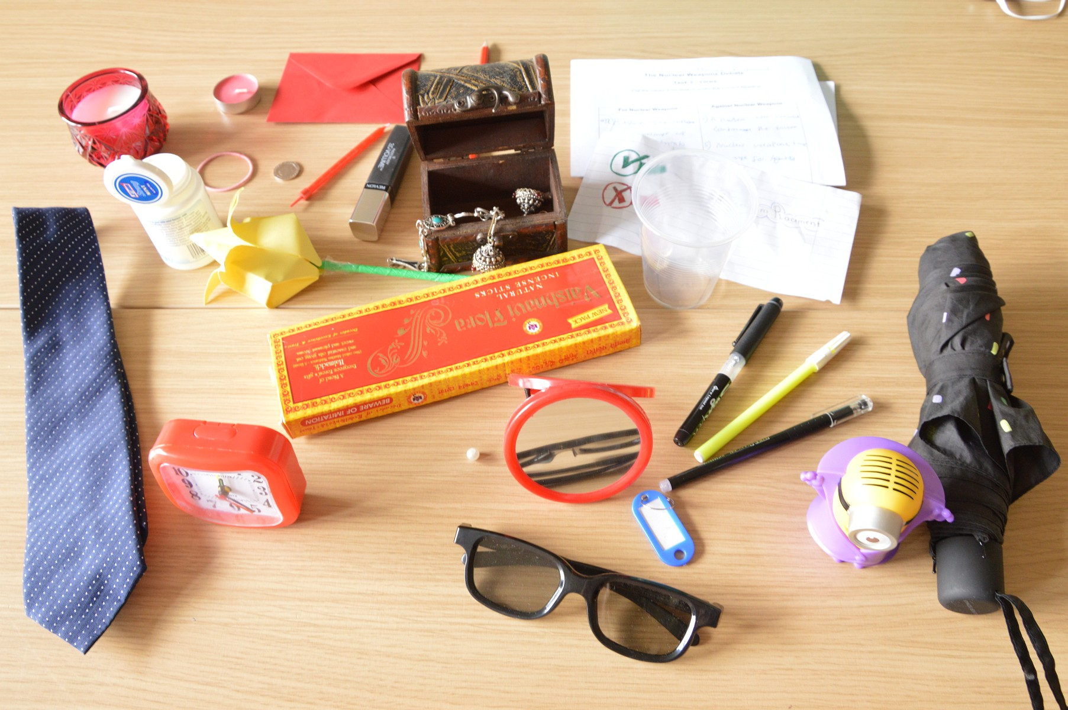
Notes:
Explanation of research context
Meaning of objects and involvement of students in this process
Challenges – students lack methodological and analytical knowledge, lack of time, sense of purpose

Slide 10
Key Points
innovating practice – LEGO® and staff-student collaboration
clear structure
competence, confidence and commitment
respect and trust
patience, nurturance and time
(Henneman, Lee and Cohen 1995)

Slide 11
We seek your assistance on the following:
If you know about other programmes that prepare professional teachers for secondary RE, please share their experiences/information
What other effective ways you know that could enlighten us more about these challenges;
-those to do with academic and believer’s perspectives,
-academic versus reflective writing,
-how to address some students’ needs if they do not have professional teaching experience
Thank You!

Slide 12
References
Christie H, Tett L, Cree VE, Hounsell J and McCune V (2008). 'A real rollercoaster of confidence and emotions': Learning to be a university student. Studies in Higher Education, 33(5): 567-581.
Goldschmid B and Goldschmid ML (1973). Modular instruction in higher education: A review. Higher Education, 2(1): 15-32.
Henneman EA, Lee JL and Cohen JI (1995). Collaboration: a concept analysis. Journal of Advanced Nursing, 21: 103-109.
Morrison K (1996). Developing reflective practice in higher degree students through a learning journal. Studies in Higher Education, 21(3): 317-332.
Quinn J (2005). Belonging in a learning community: The re-imagined university and imagined social capital. Studies in the Education of Adults, 37(1): 4-17.
Read B, Archer L and Leathwood C (2003). Challenging cultures? Student conceptions of 'belonging' and 'isolation' at a post-1992 university. Studies in Higher Education, 28(3): 261-277.

Slide 13
Partnership for Learning
collaboration between staff and students to develop innovative approaches to teaching and learning
Nicole Brown
@ncjbrown
www.nicole-brown.co.uk
#STEPTL

