Slide 1
Academic identity: active identity and body work in academia
Nicole Brown
@ncjbrown @FibroIdentity
www.nicole-brown.co.uk

Slide 2
Academia
an ivory tower?

Slide 3
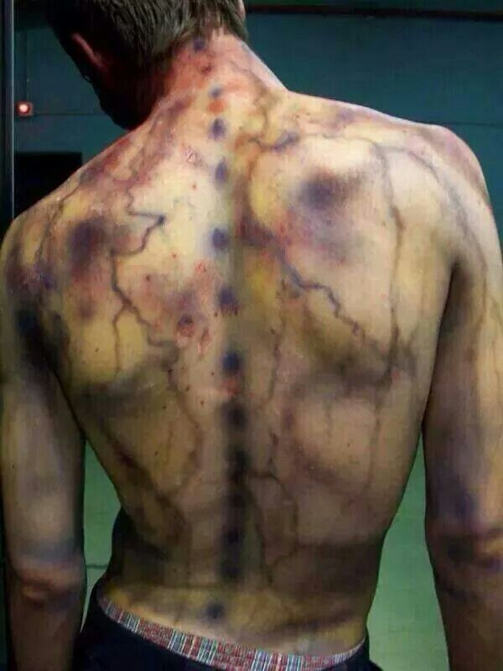
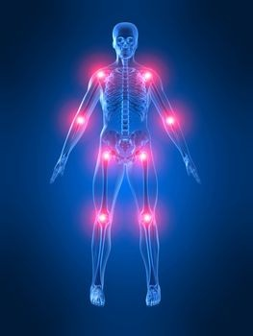
Fibromyalgia – complex and contested

Slide 4
Participatory and creative research
Power differential
Getting closer to experiences – holistic view
Richer data
-> Timelines and identity boxes with conversations

Slide 6
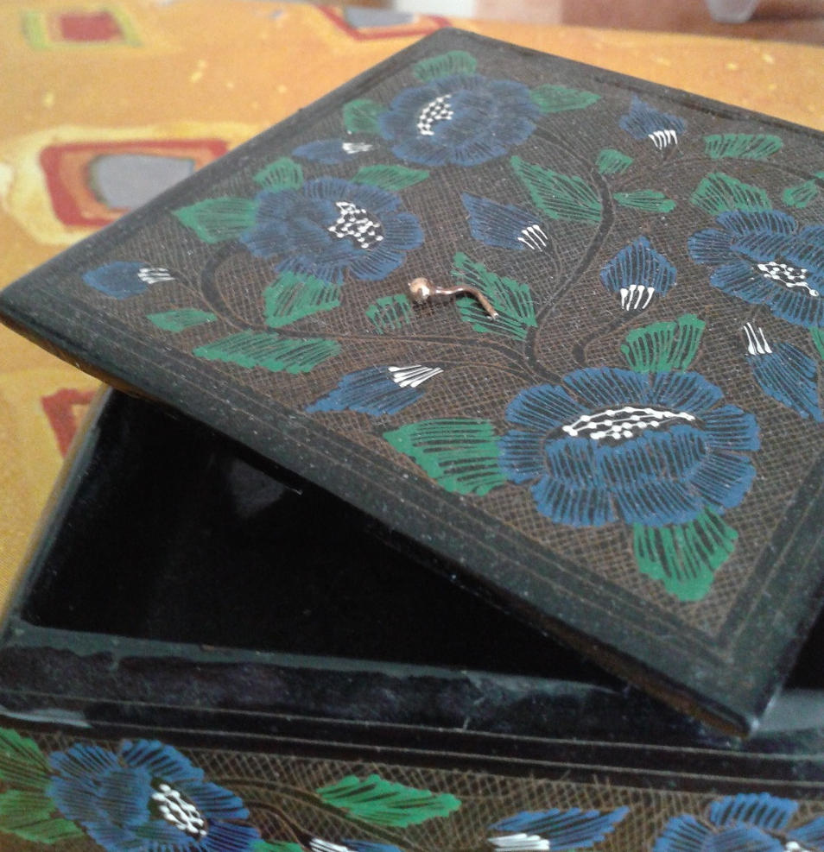
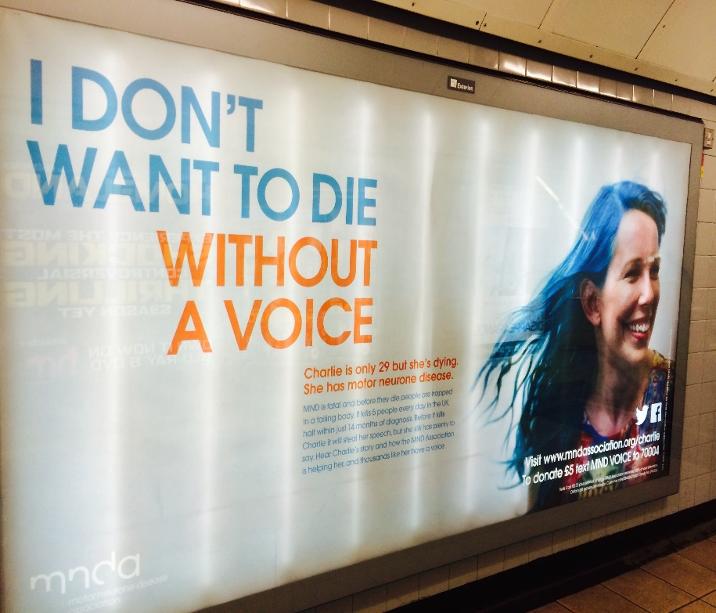

Slide 7
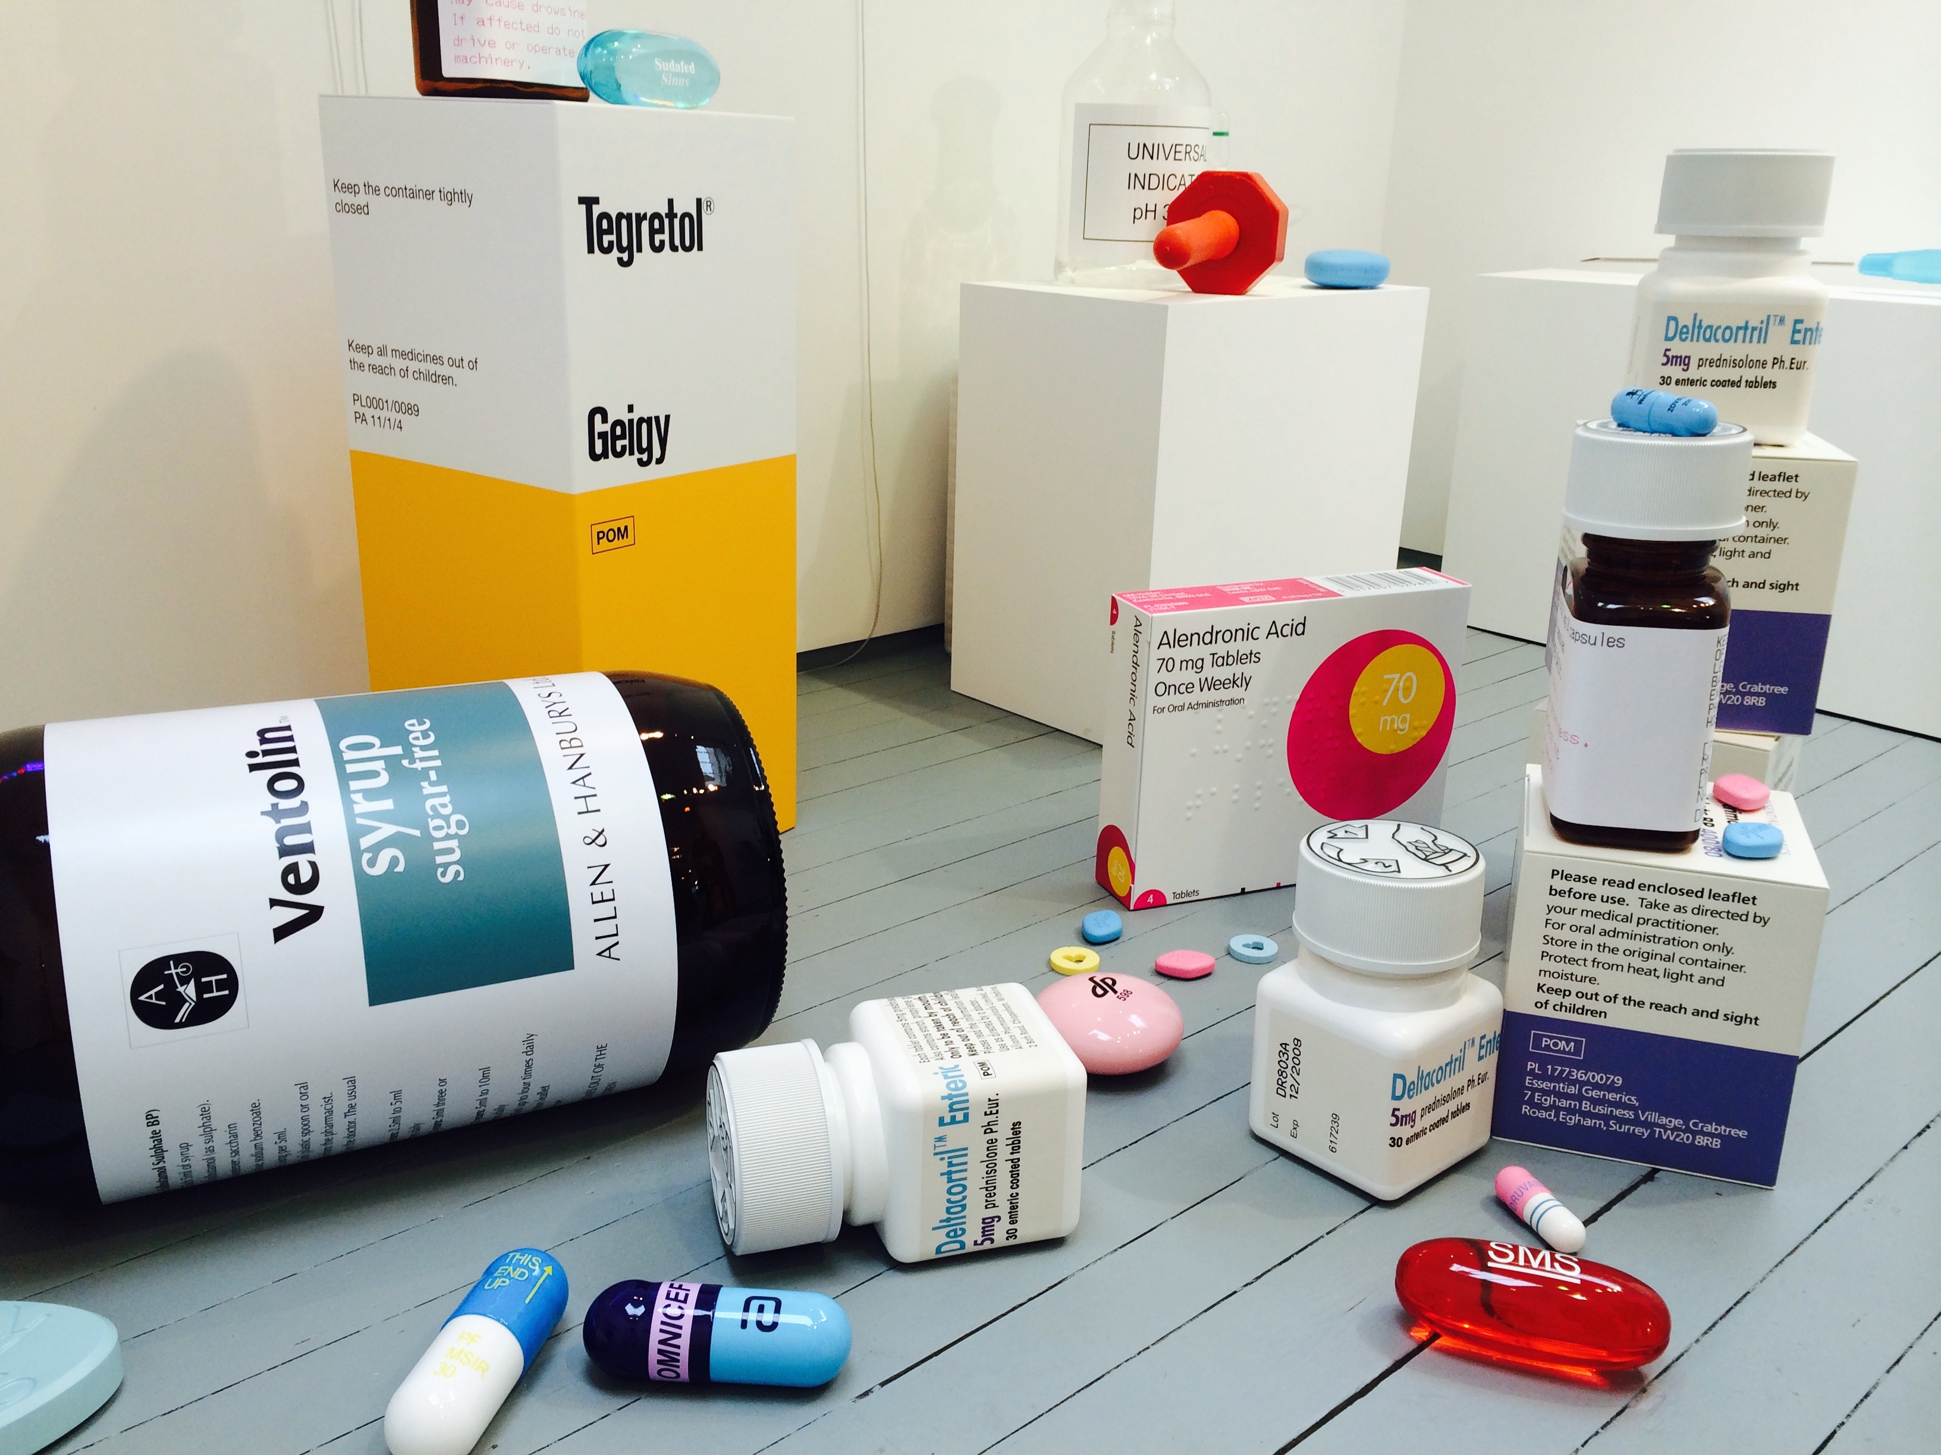
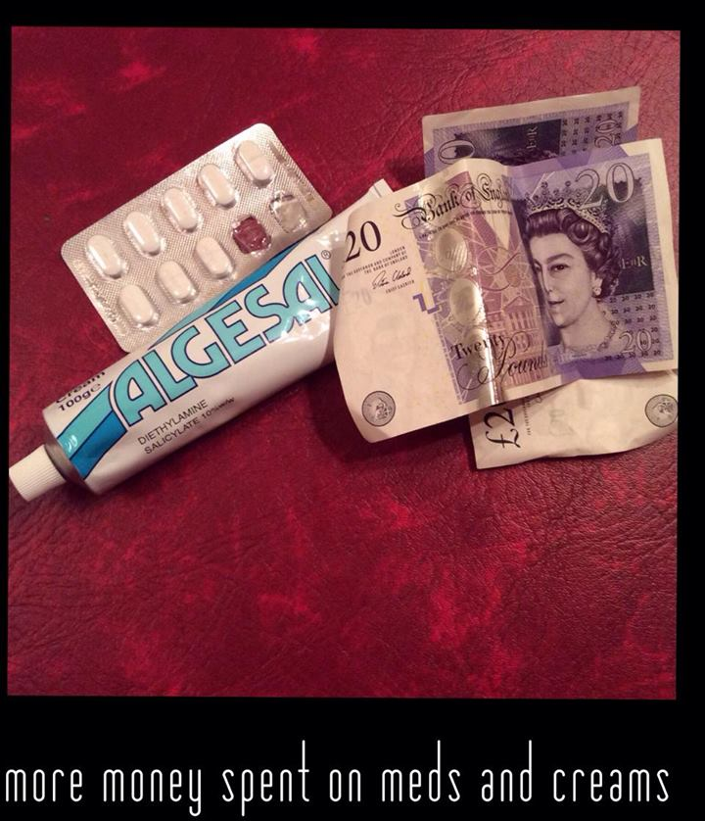

Slide 8
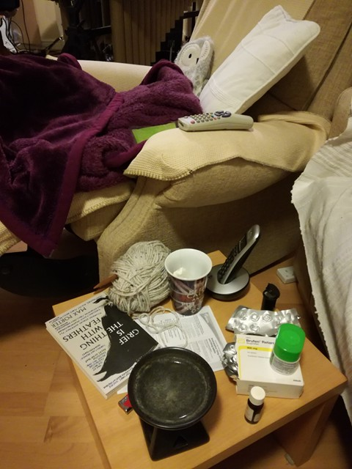
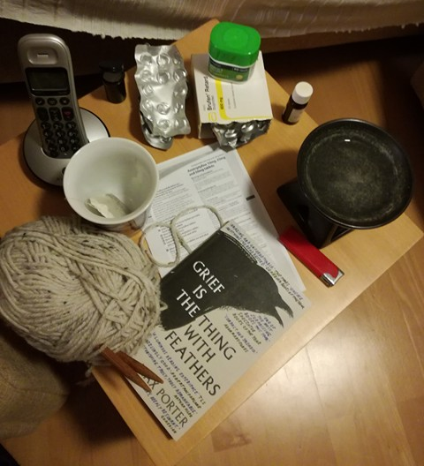

Slide 9
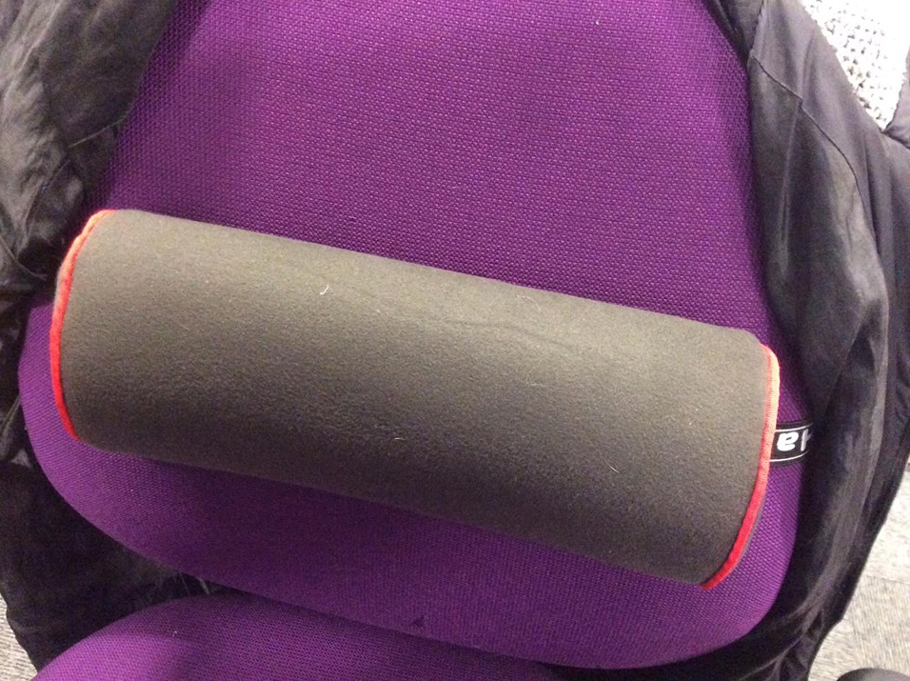
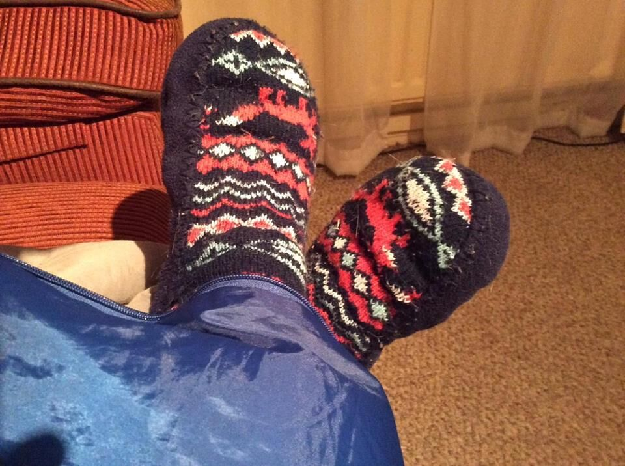

Slide 10
Academic identity: active identity and body work in academia
Nicole Brown
@ncjbrown @FibroIdentity
www.nicole-brown.co.uk

