Slide 1
Recreating experiences:
participatory qualitative research to develop student learning and experience
Nicole Brown
@ncjbrown
www.nicole-brown.co.uk

Slide 2
Background
teaching, scholarship and research-based education within HE
student voice and the student as consumer
narrative and creative research methods
power and authority of researcher

Slide 3
Context
STEP Programme
students' reflections
human life and language connected with metaphors (Lakoff and Johnson, 1980)

Slide 4
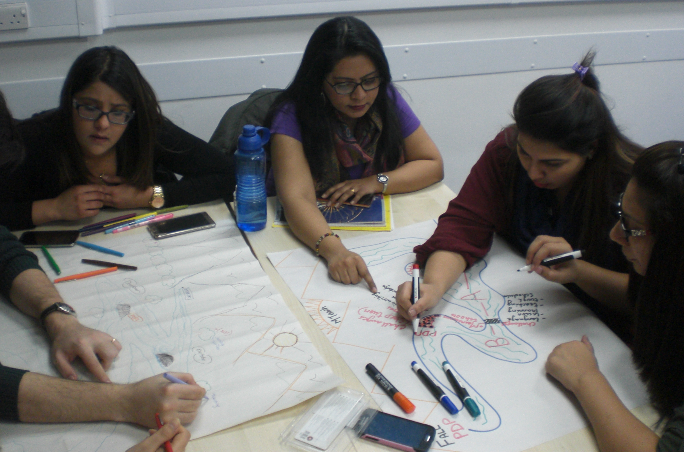

Slide 5
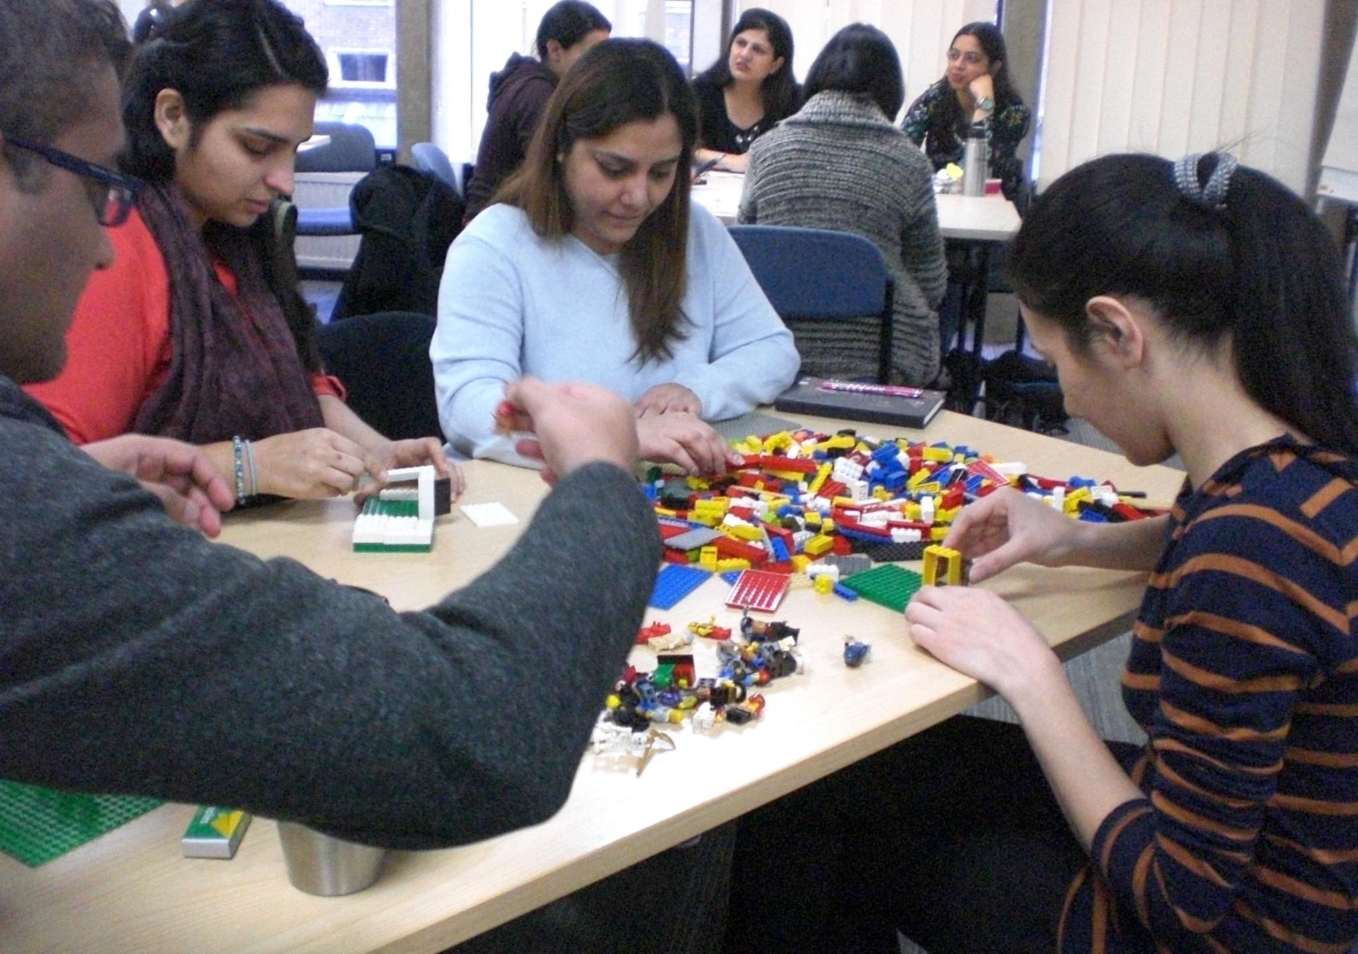

Slide 6
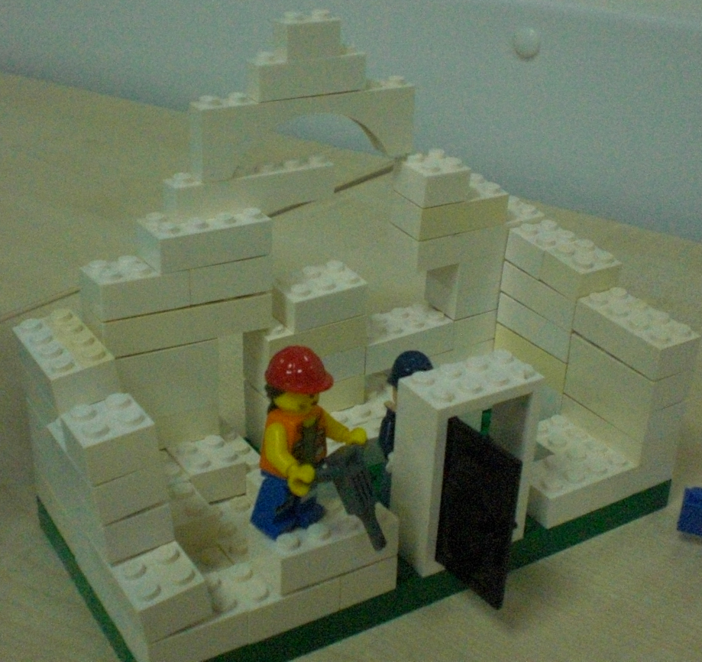
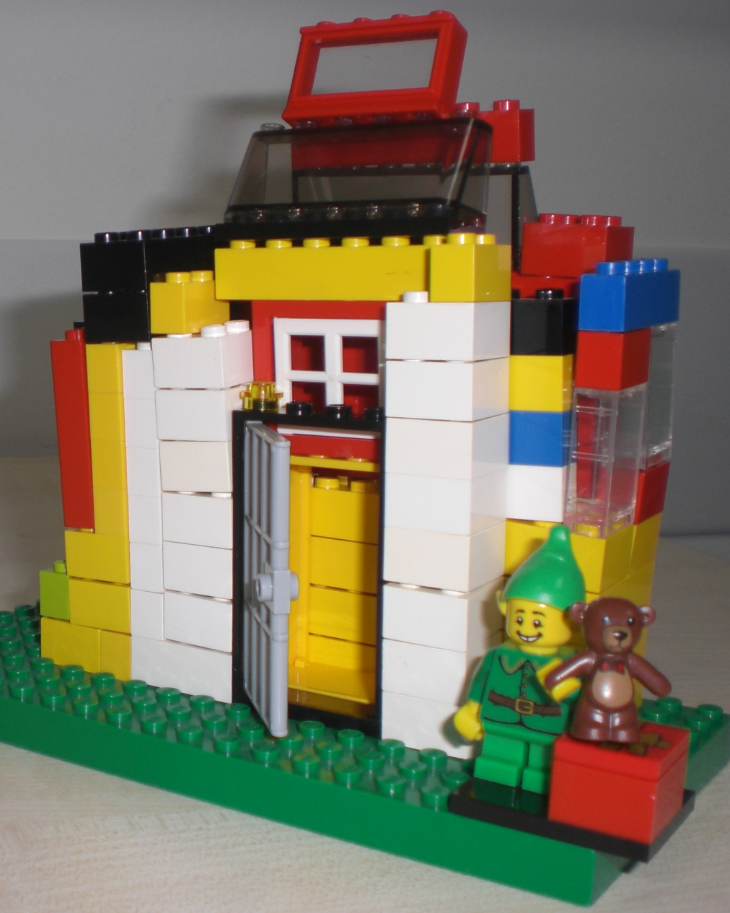
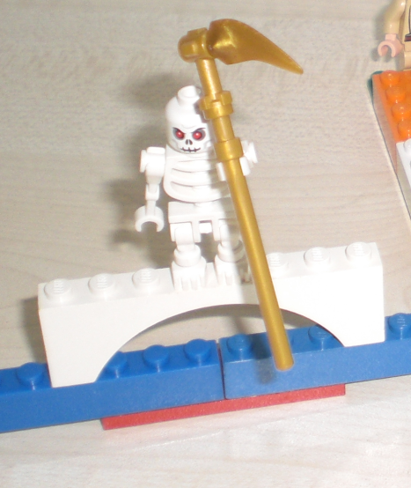

Slide 7
Aims
to use students' reflections
to use artefacts and metaphors
to have students as true partners rather than participants or objects
to allow student to take active role in meaning-making process

Slide 8
Process
expression and recreation of experiences
"co-researchers" and their peers
data collection and analysis

Slide 9
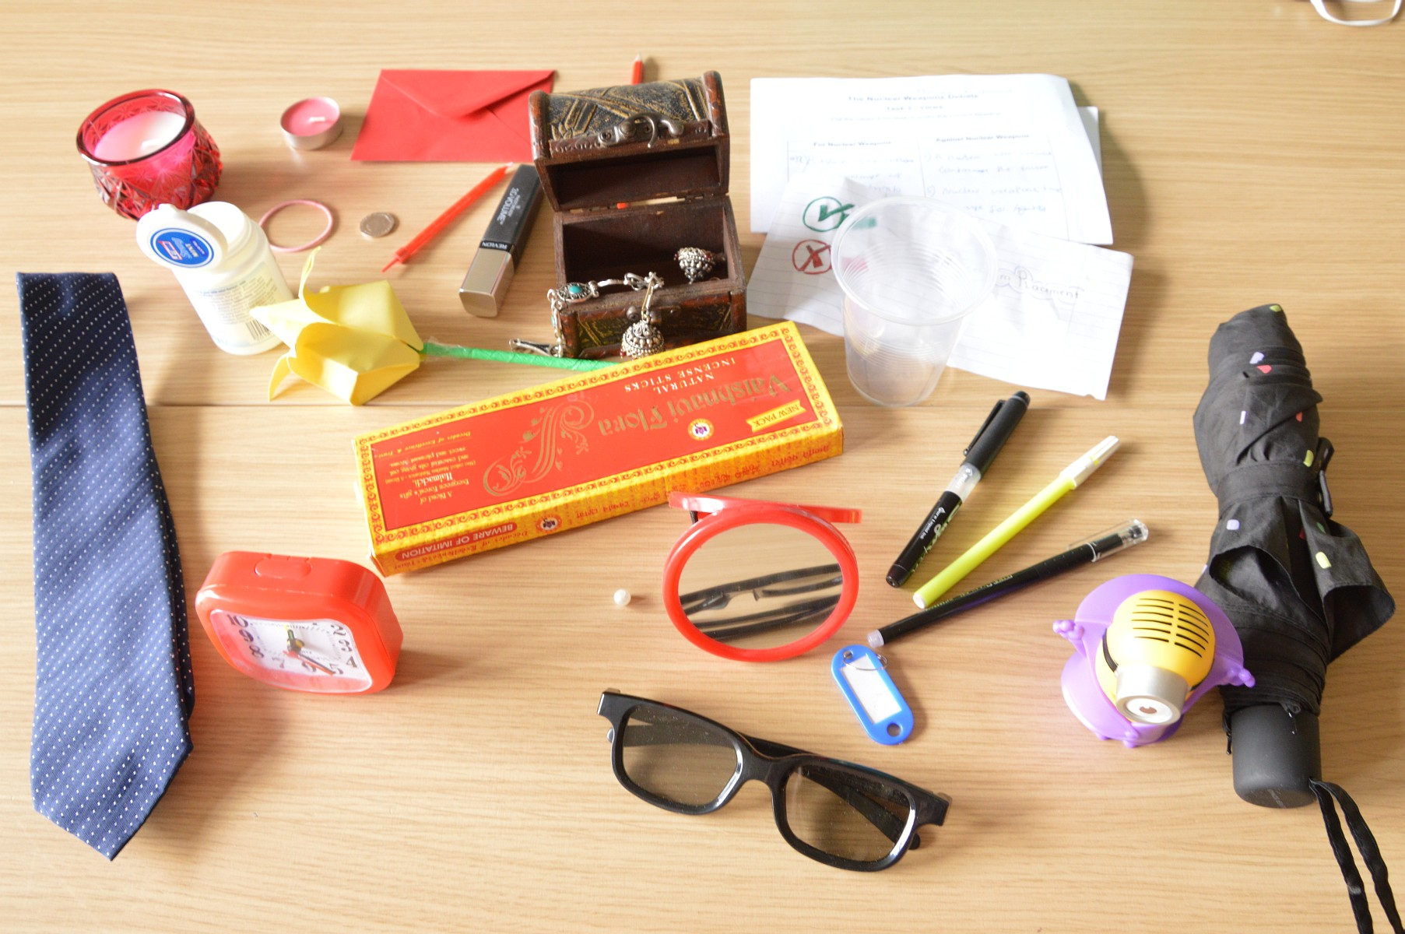

Slide 10
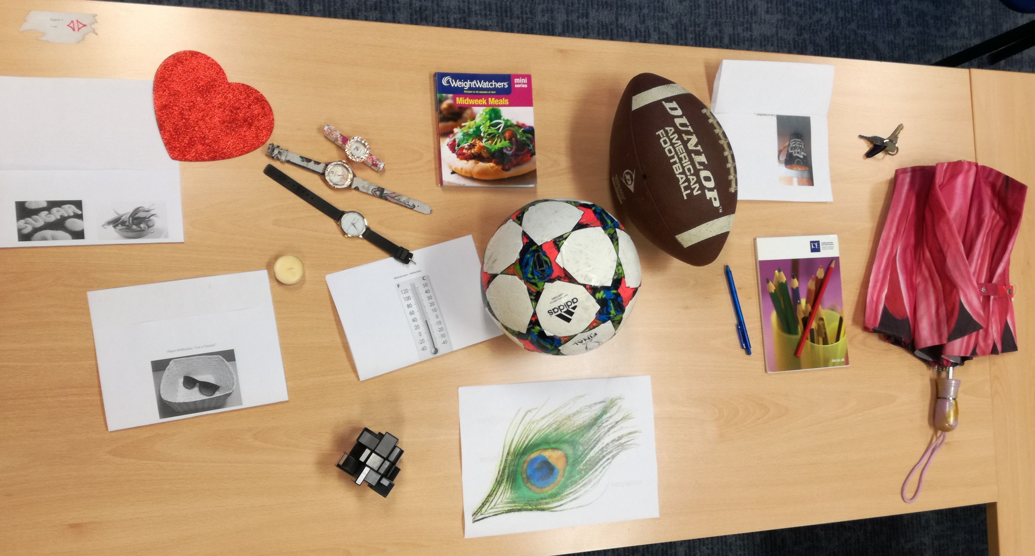

Slide 11
Outcomes
development of research literacy
practice of research skills
findings used for future cohorts' benefits

Slide 12
Benefits of metaphors and artefacts
expressing what may otherwise be difficult to express
deeper reflections through reduction and elaboration – finding the essence
breaking down insider-outsider role of researcher

Slide 13
Pitfalls of metaphors and artefacts
unusual means – lack of understanding
time constraint of meaning making
not everything can be expressed with metaphors
focus on aesthetics

Slide 14
Advantages of staff-student research
ownership and responsibility
developing self-regulated learning and independence
improved understanding of community of practice and learning
improved teaching and learning

Slide 15
Challenges of staff-student research
time constraints
differences in knowledge base
trust, commitment and dedication
change takes time

Slide 16
Recreating experiences:
participatory qualitative research to develop student learning and experience
Nicole Brown
@ncjbrown
www.nicole-brown.co.uk

