Slide 1
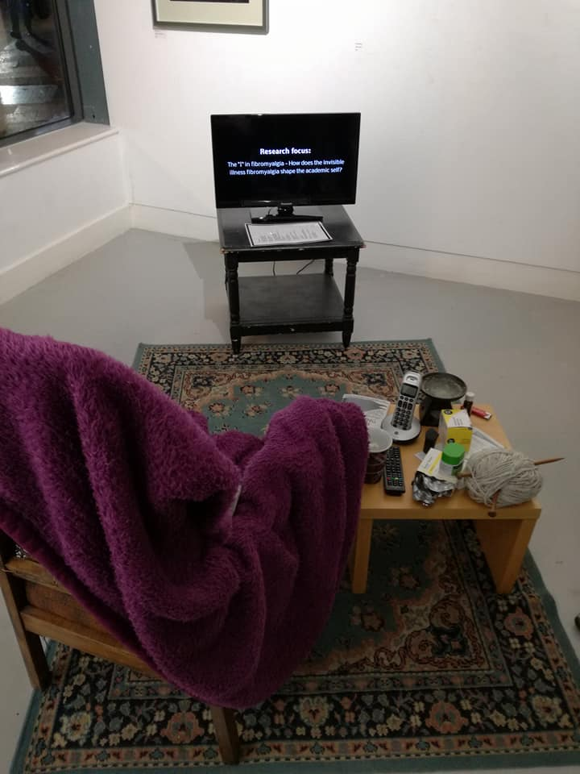
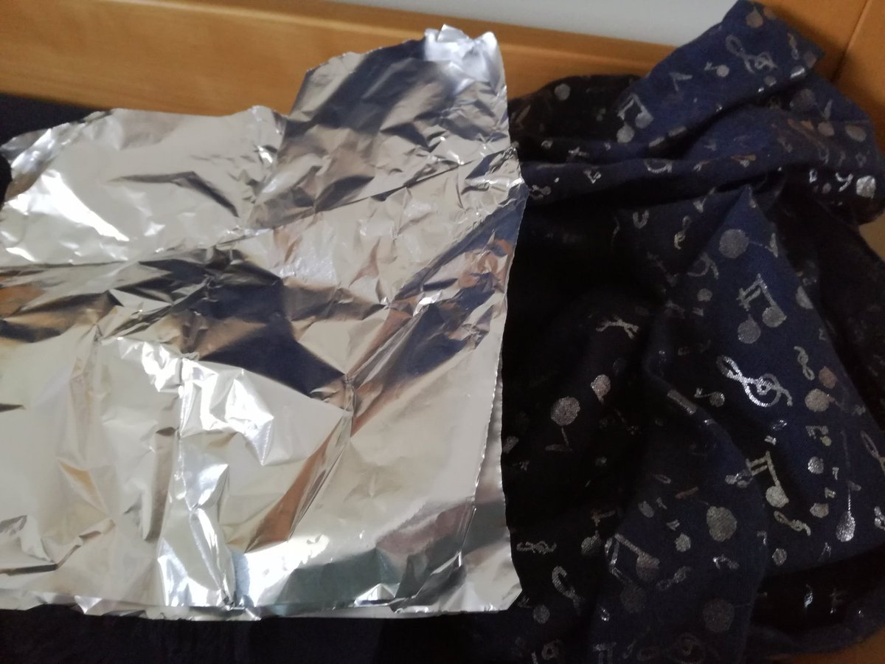
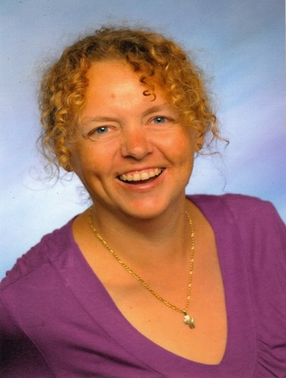
Research Impact of
“Academic Identity under the Influence of Fibromyalgia”
The research
Fibromyalgia is a complex, invisible illness on the cusp of the physical, somatic and psychological. It is characterised by chronic, wide-spread pain, fatigue, sleep disturbances, cognitive dysfunctions, increased sensitivity and psychological disorders (White and Harth, 2001).
My research aims to provide a holistic view of the lived experience of fibromyalgia and to explore how academics make sense of their academic identities under the influence of fibromyalgia.
Data shows that many academics do not declare fibromyalgia as the condition is not understood well enough. Academics worry that they will be seen as unsuccessful or failing.
Ableism in academia
Art installation “Peace Treaty”
Conference on the 23rd March 2018
Research findings led to a fully
inclusive and accessible inter-
institutional conference on the topic
of “Ableism in Academia” (BSL interpreters, livestream, live captioning, catering for all dietary requirements, “quiet room”, etc.). The debate is still ongoing on twitter via @AbleismAcademia, #AIA2018 and #LTHEchat.
Objects arranged around the armchair and side table show how fibromyalgia is managed, while two simulation videos are screened on the TV to demonstrate the cognitive dysfunctions.
Through artistic means the installation informs, teaches, raises awareness, develops empathy and understanding and thus aims to have a long-lasting effect on gallery visitors.
The Horsebridge Arts Centre, Whitstable, January 2018.
Publications
Ableism in academia: where are the disabled and ill academics? in Disability and Society: https://doi.org/10.1080/09687599.2018.1455627
Making conferences and academia more accessible (article with practical recommendations, forthcoming).
Theorising and negotiating ableism in academia (books forthcoming)
Continuing the conversations
Further conference speeches and invited keynotes are already planned within and beyond the initial sponsors and supporters.
Changes in the public sphere
Through the creative methods and simulations members of the public gain better understanding of invisible illnesses and disabilities.
I have used materials and objects such as aluminium foil and a scarf to simulate stiff joints and reduced mobility in order to provide better insight in the ableist environment in shops or cafés.
The Faversham branch of Sainsbury’s has changed training for staff at check out tills.
Staff training and lighting have been
changed in the Gulbenkian at Kent.
Data collection (Brown, 2018)
Timelines, diary entries, CV
Interviews
and discussions
Identity boxes
Drawing on
Interpretative Phenomenological
Analysis (Smith et al., 2012)
Representa-
tions
Ableism beyond academia
Disability charter
Contact: Nicole Brown
nicole.brown@ucl.ac.uk
www.nicole-brown.co.uk
NADSN uses the contributions from the conference, twitter debates and publications to create a disability charter for academia and businesses.

