Slide 1



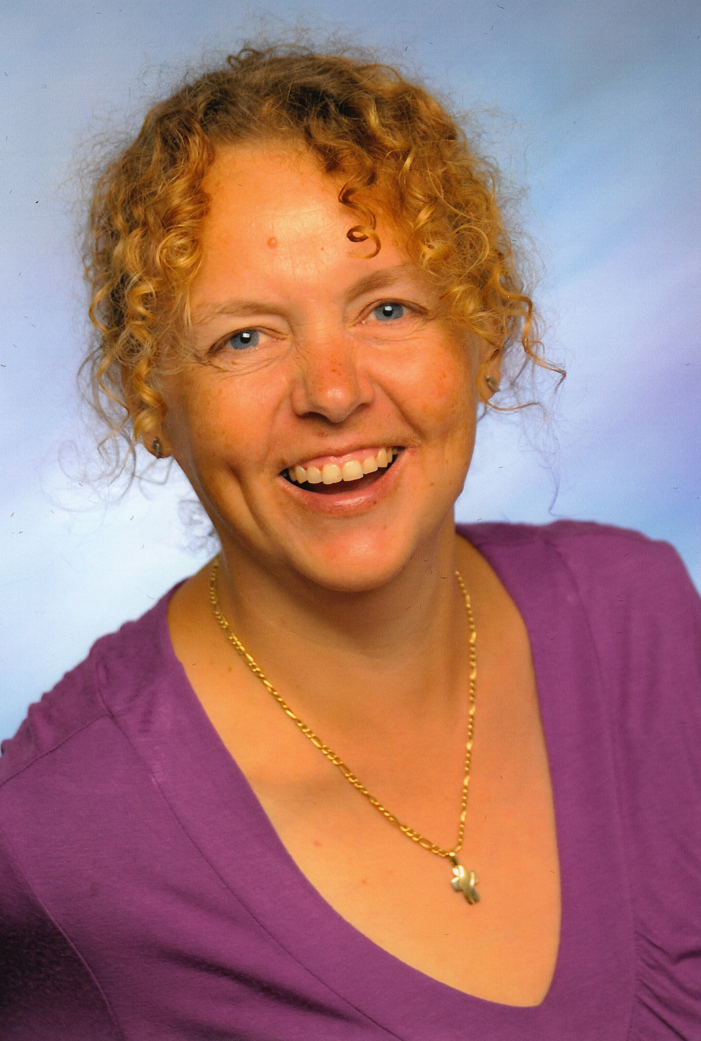
Using creative methods to support PhD students’ well-being
Jo Collins
@pgdevadvisor
j.p.collins@kent.ac.uk
Nicole Brown
@ncjbrown
www.nicole-brown.co.uk
nicole.brown@ucl.ac.uk

Slide 2
Overview
Context of workshop
  Kent GradSchool student feedback
  Relevance for PhD students
Elements of the student workshop
  Objects: Who am I?
  River-drawing: What does your learning journey look like?
  LEGO®: What is your PhD?
Evaluation of workshop
  What are well-being and resilience
  Benefits and limitations
  Role of the creative methods

Slide 3
Why PhD students’ Well-being?
Challenges:
  Isolation/Community
  Conceptual sophistication/advancement of the field
  Motivation
  Scope of project
  Uncertainty

Slide 4
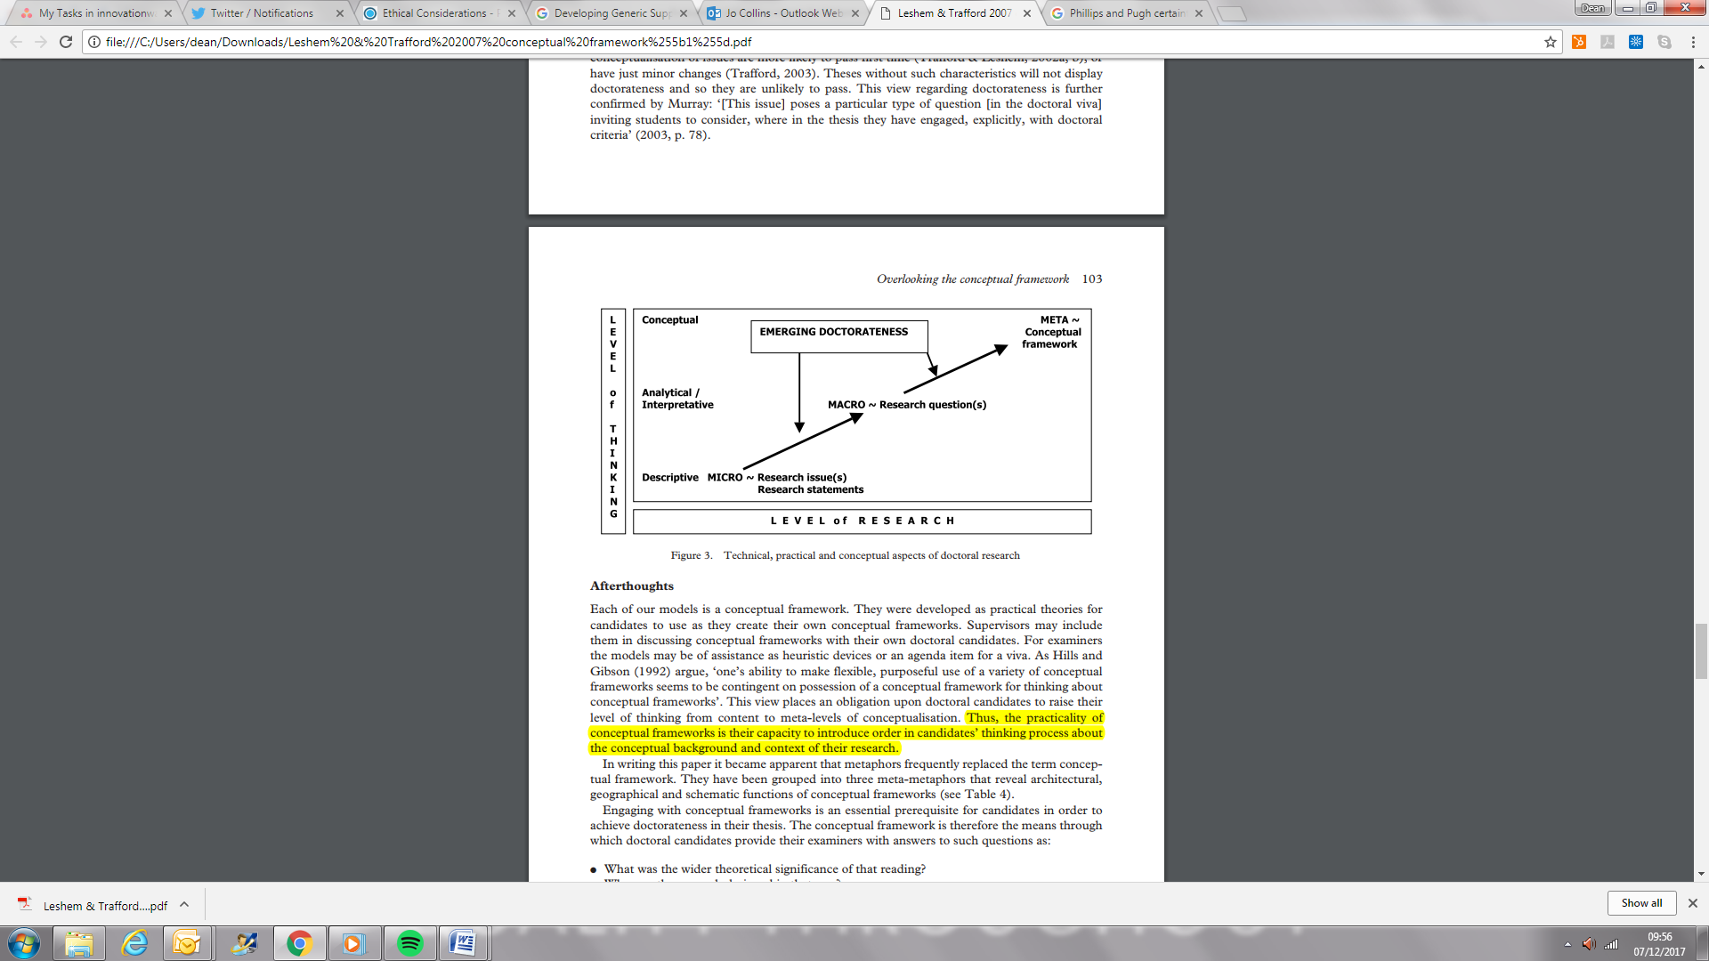
Lesham and Trafford

Slide 5
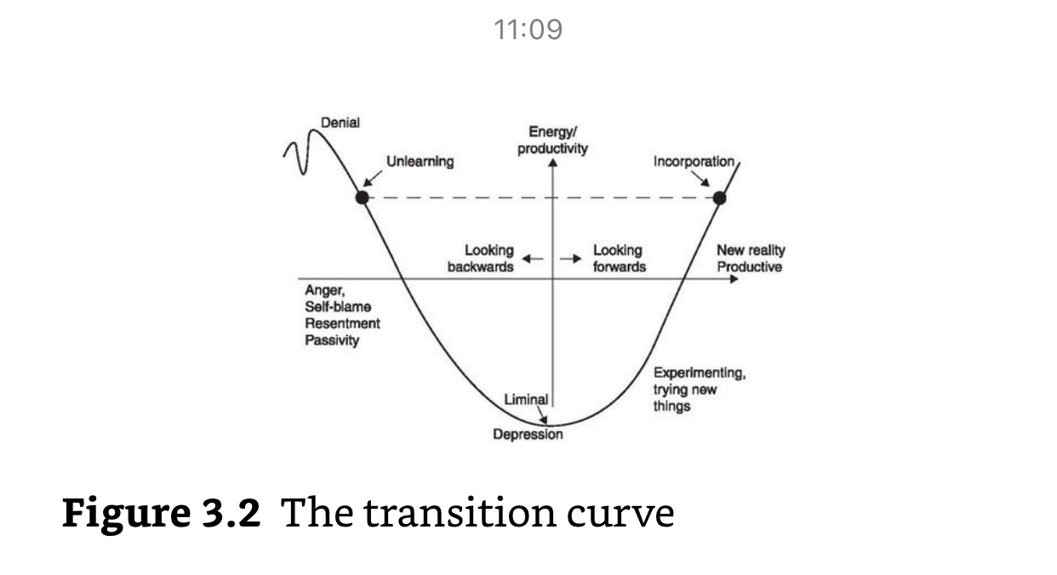
PhD as a rite of passage
Elisabeth Kubler-Ross

Slide 6
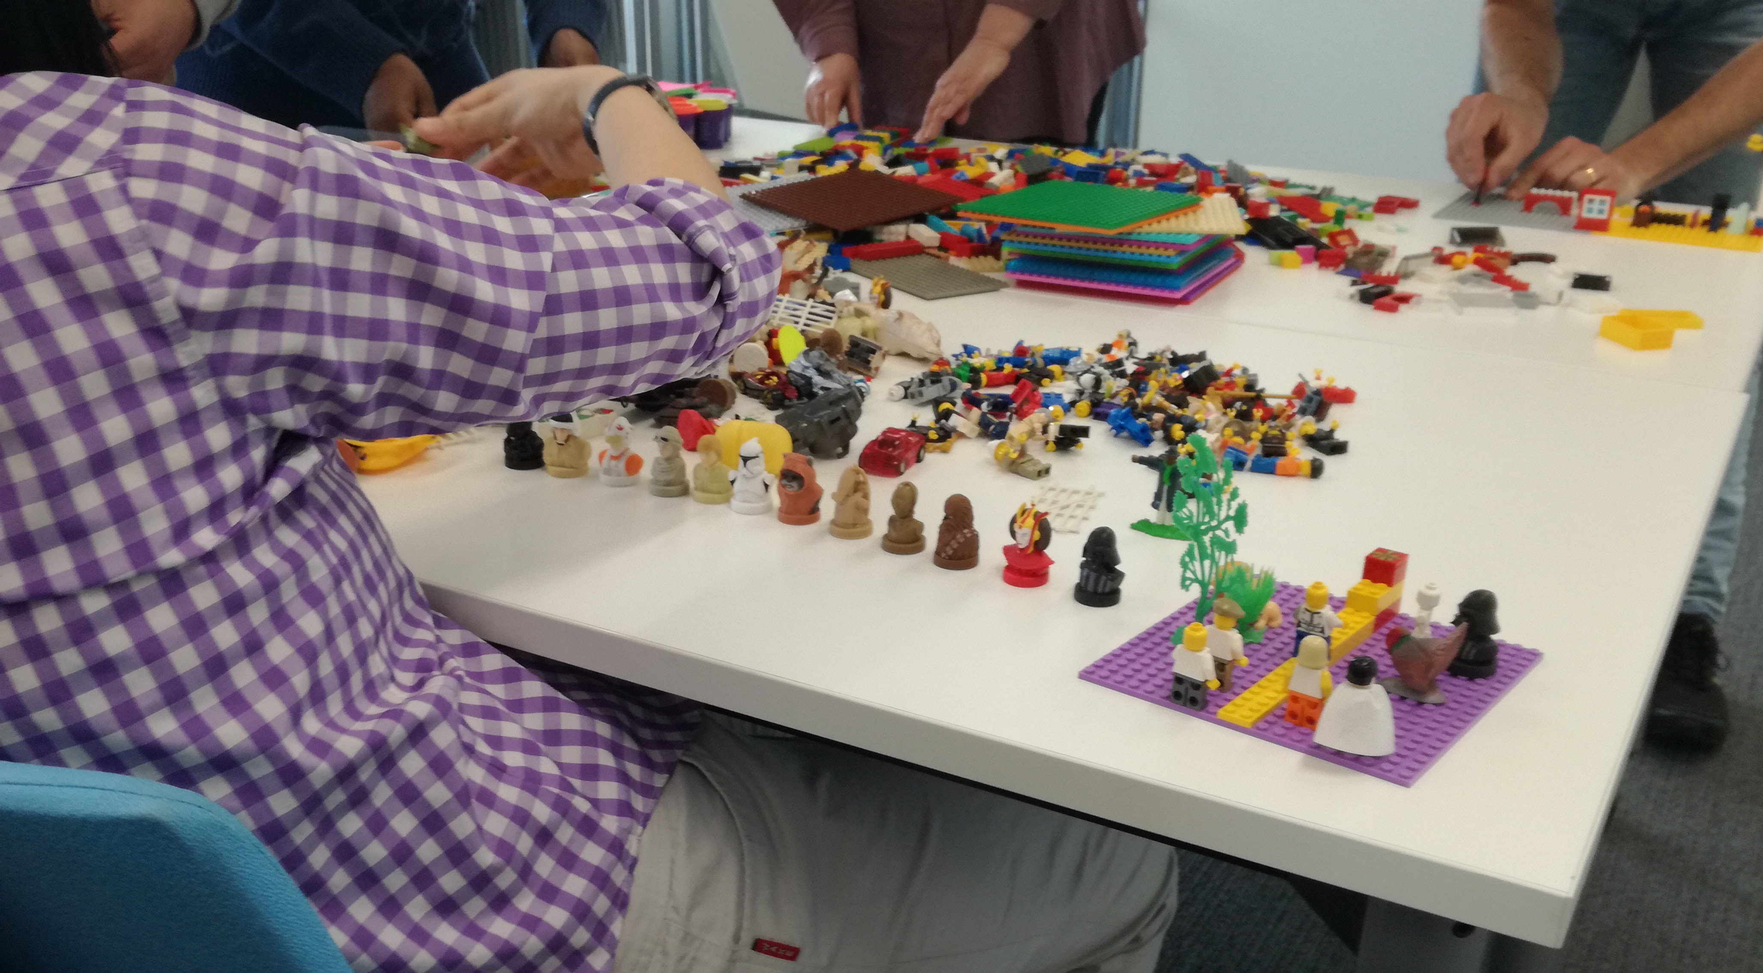
Let’s make and do….

Slide 7
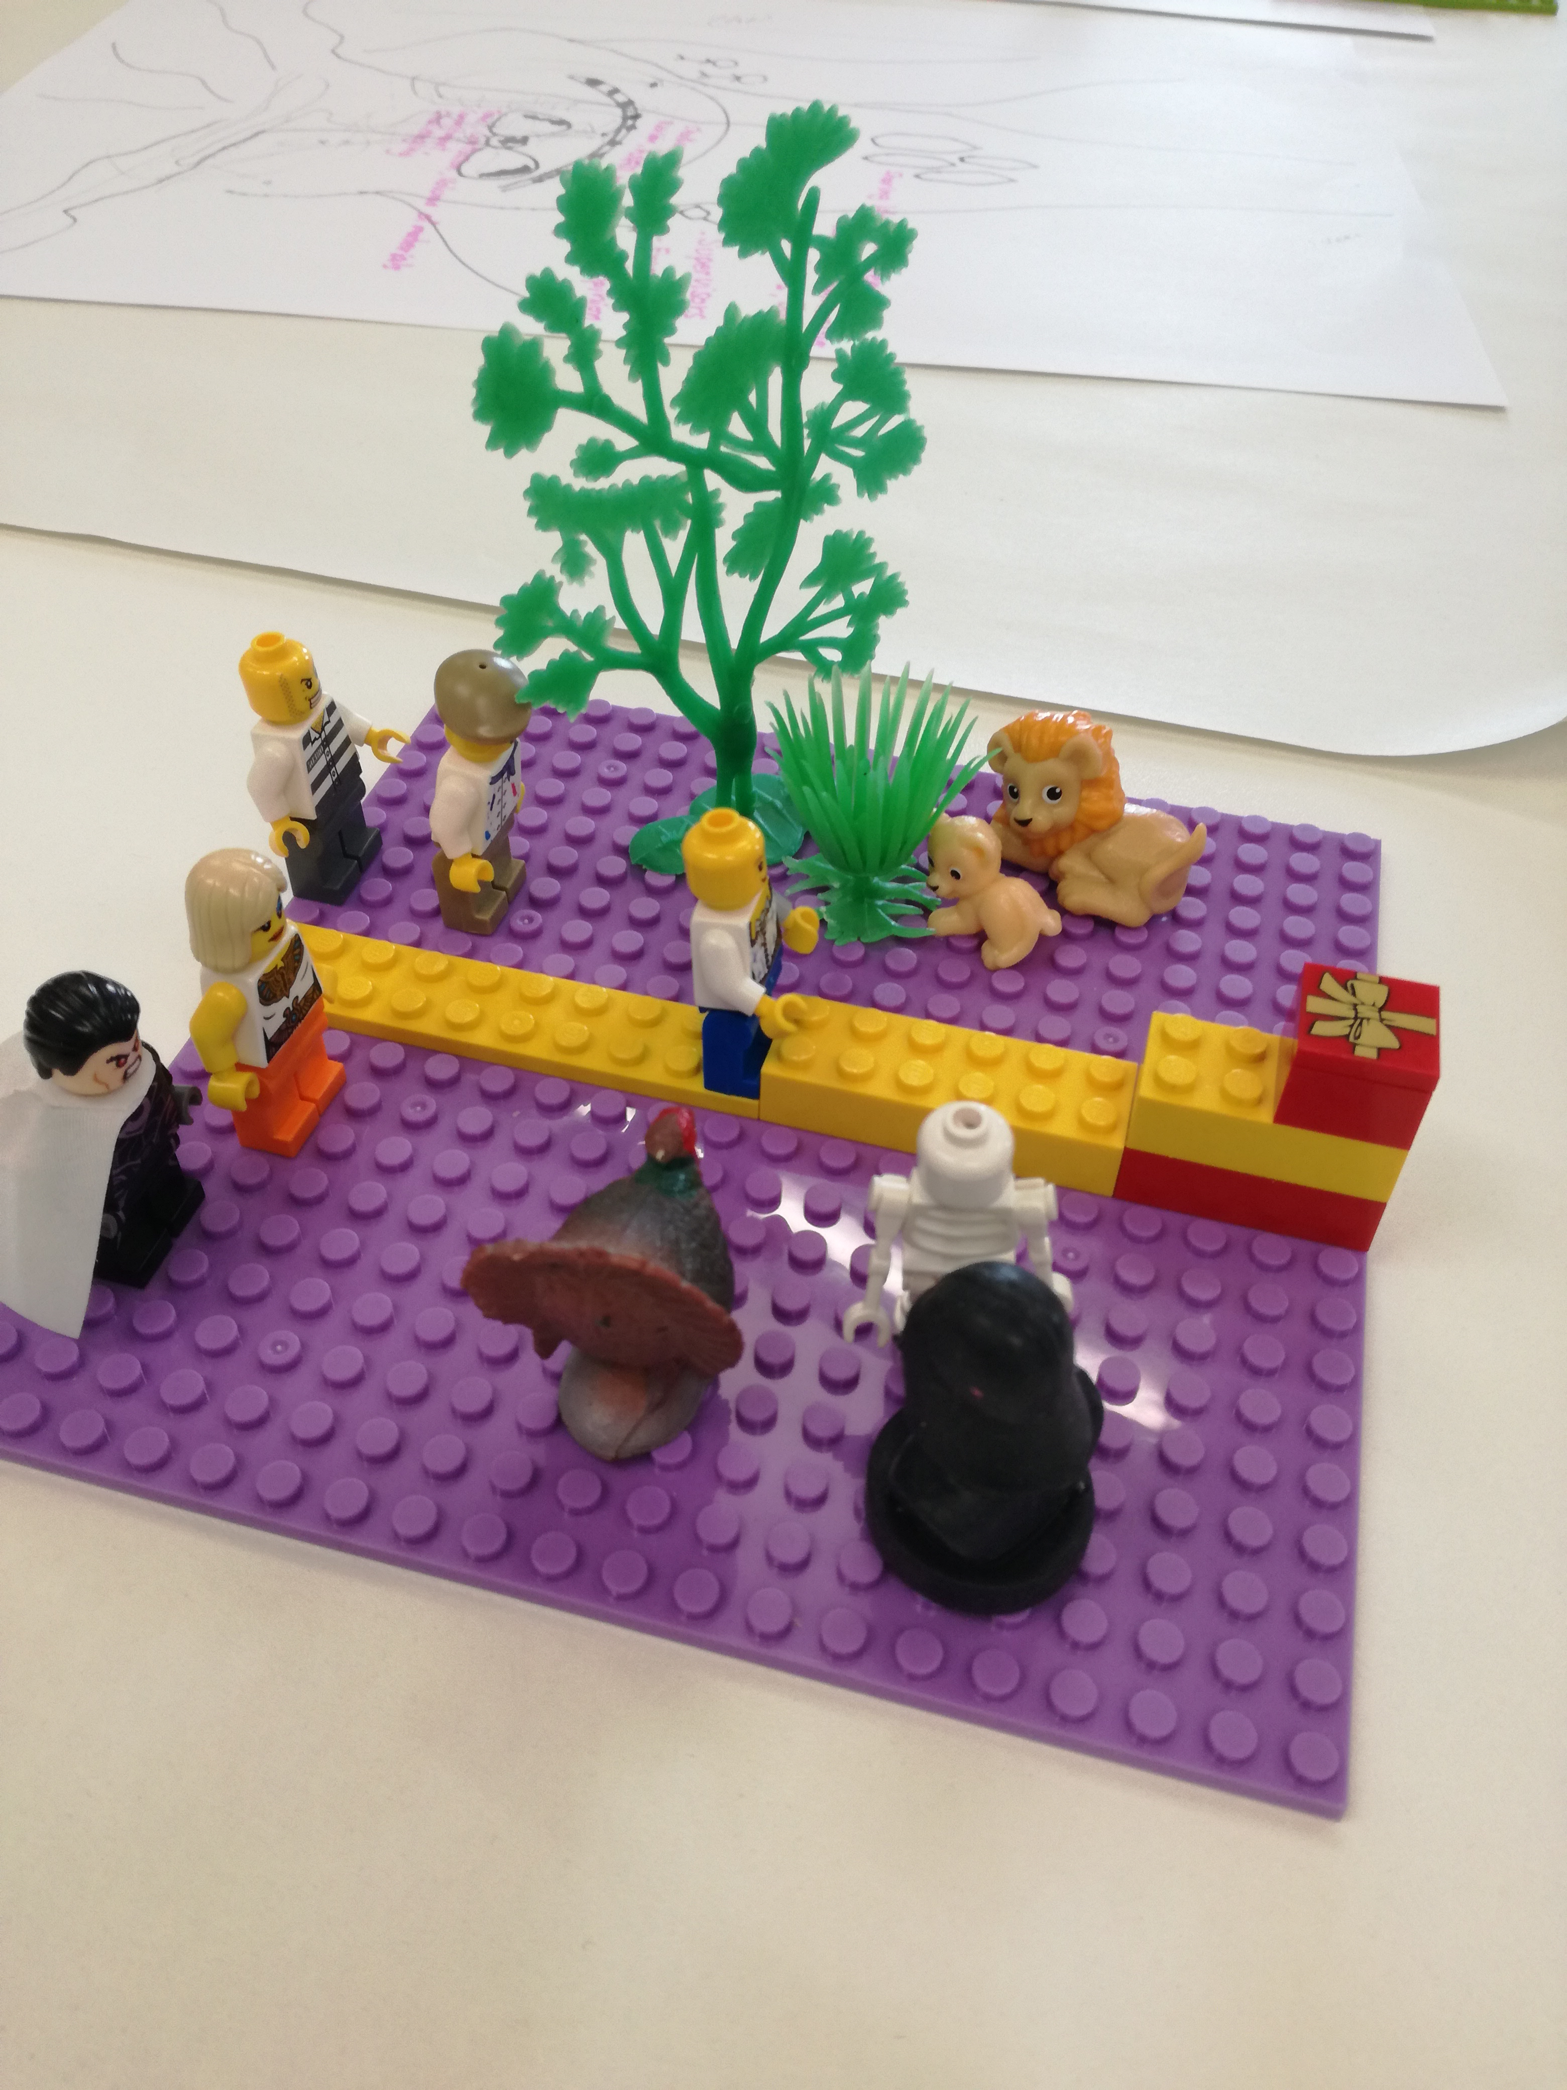
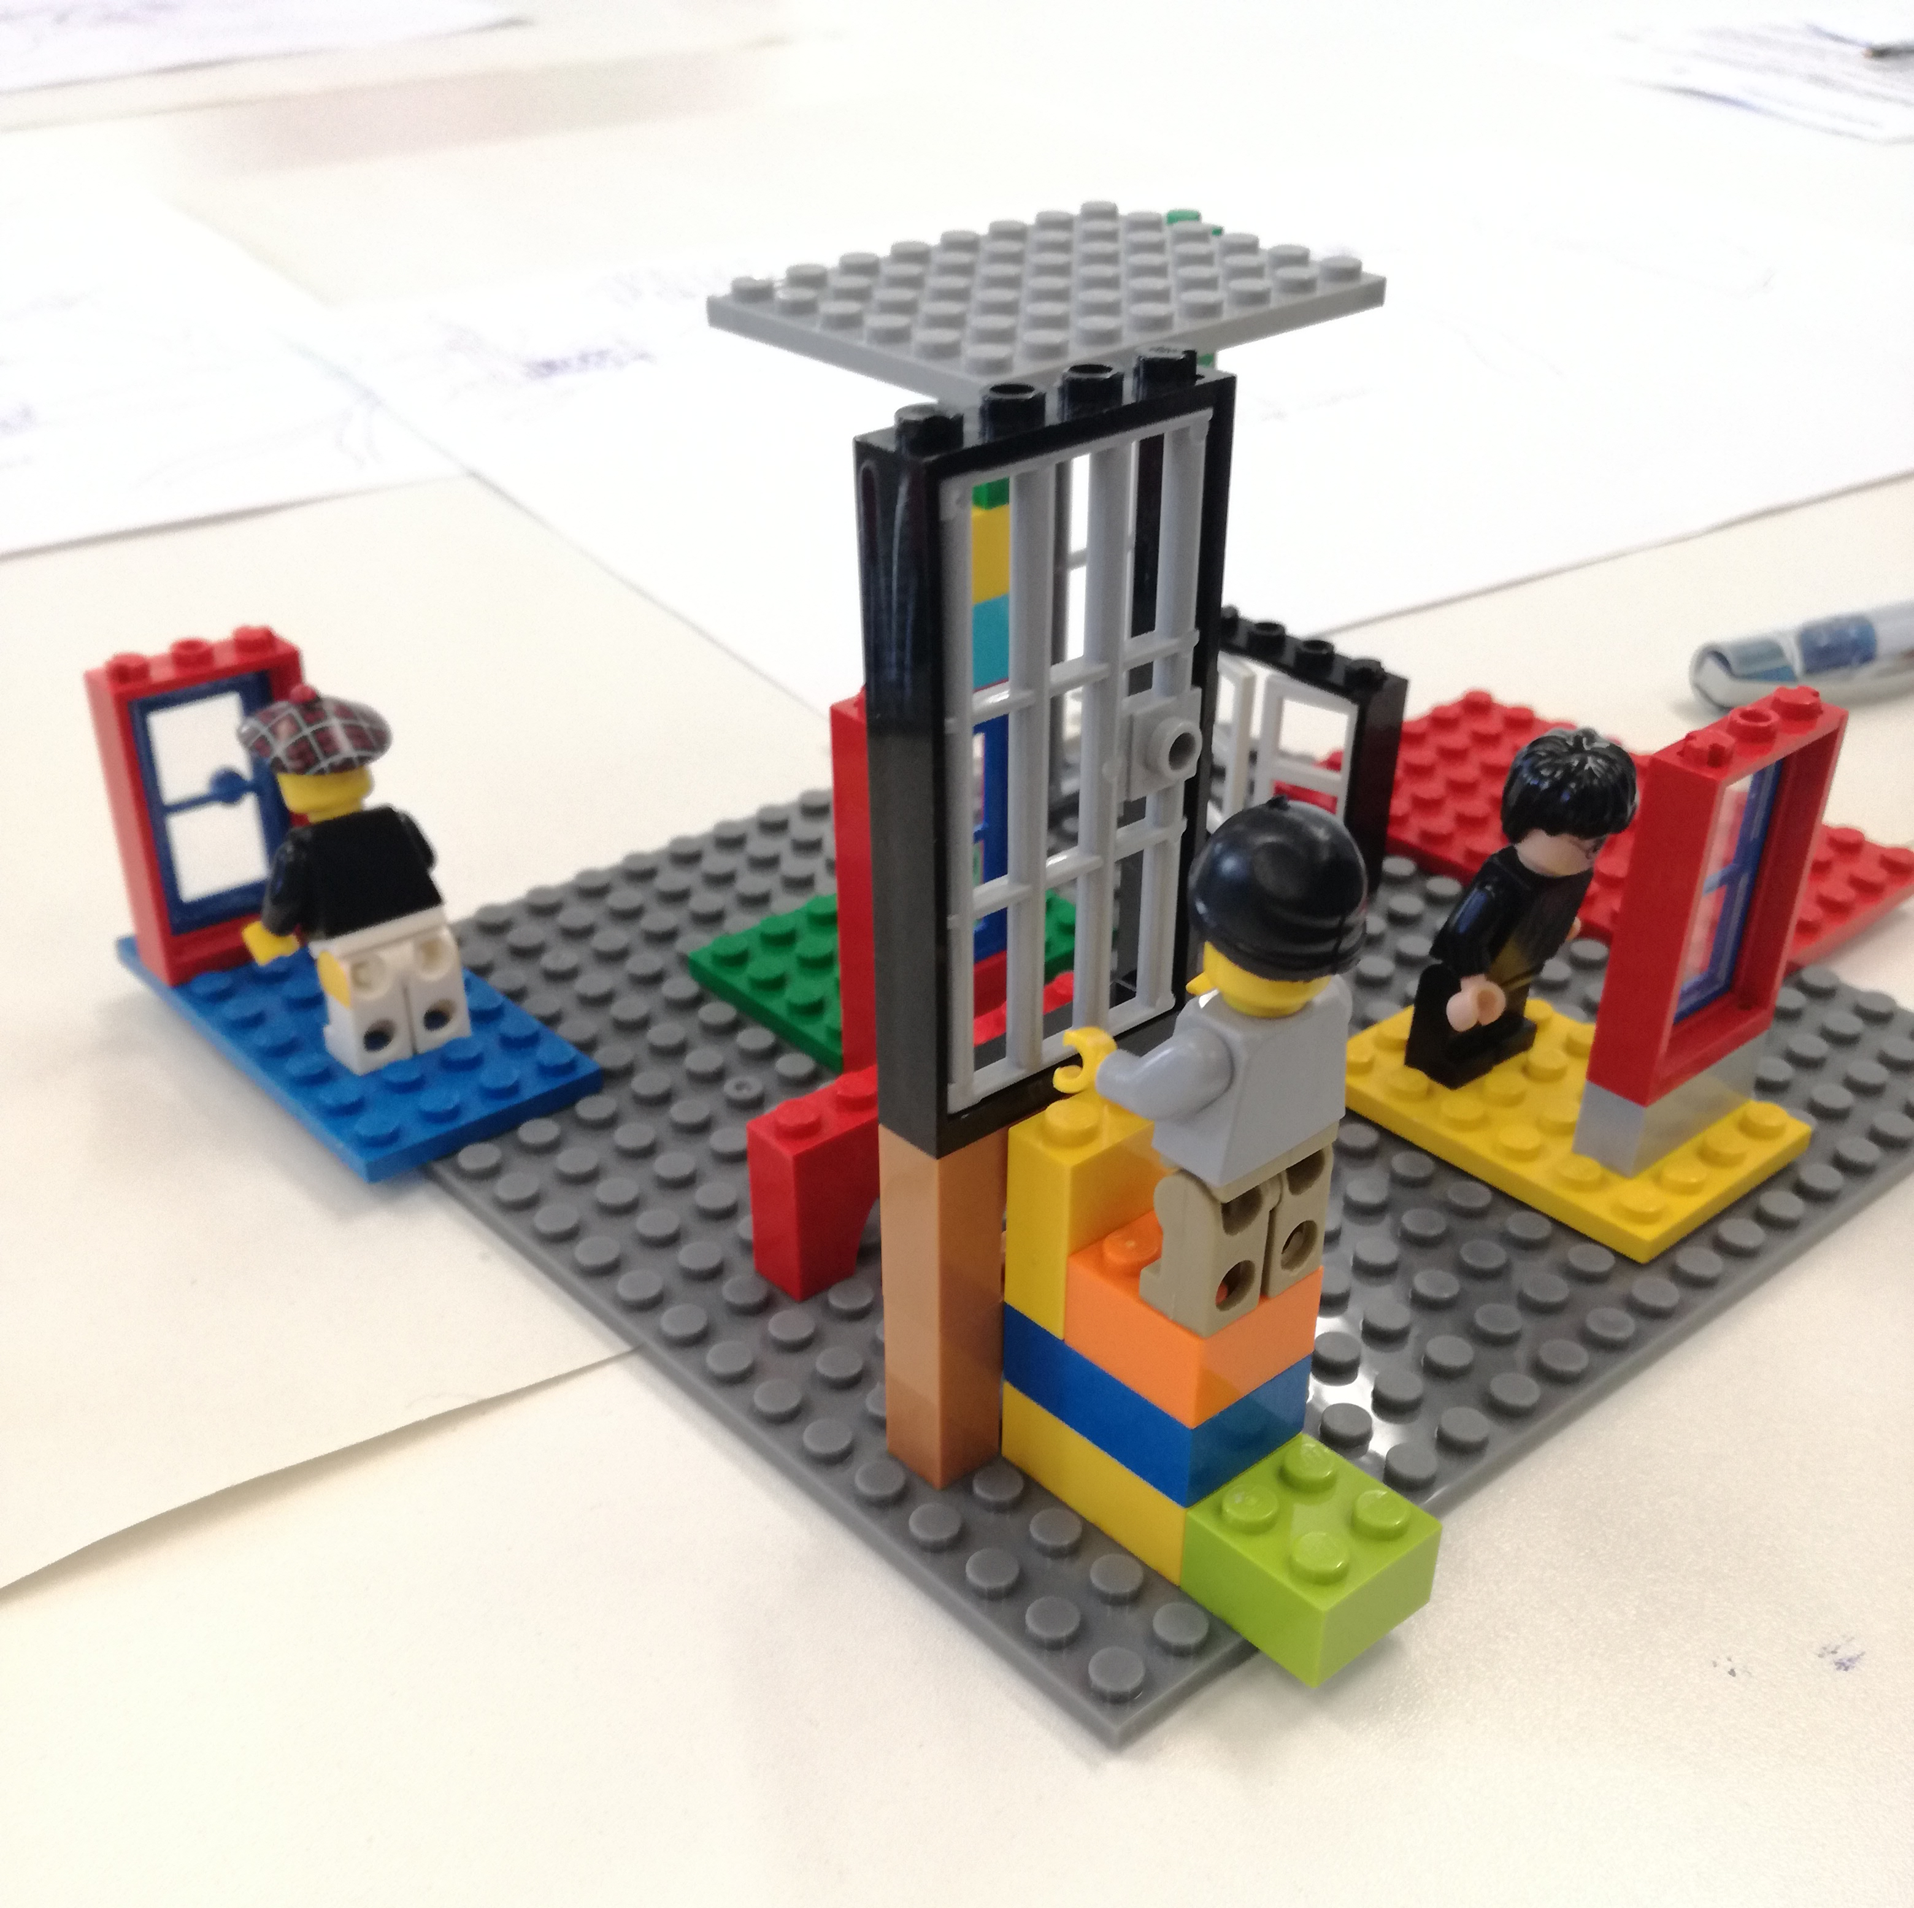

Slide 8
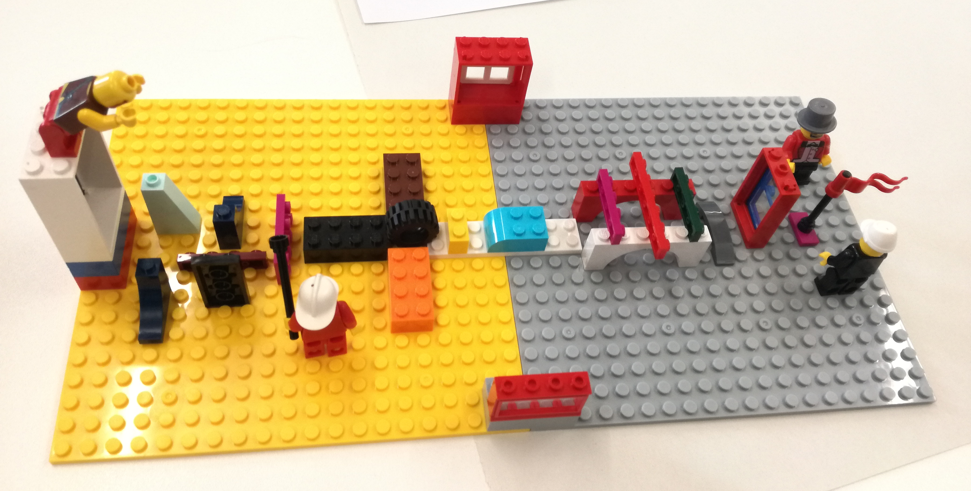
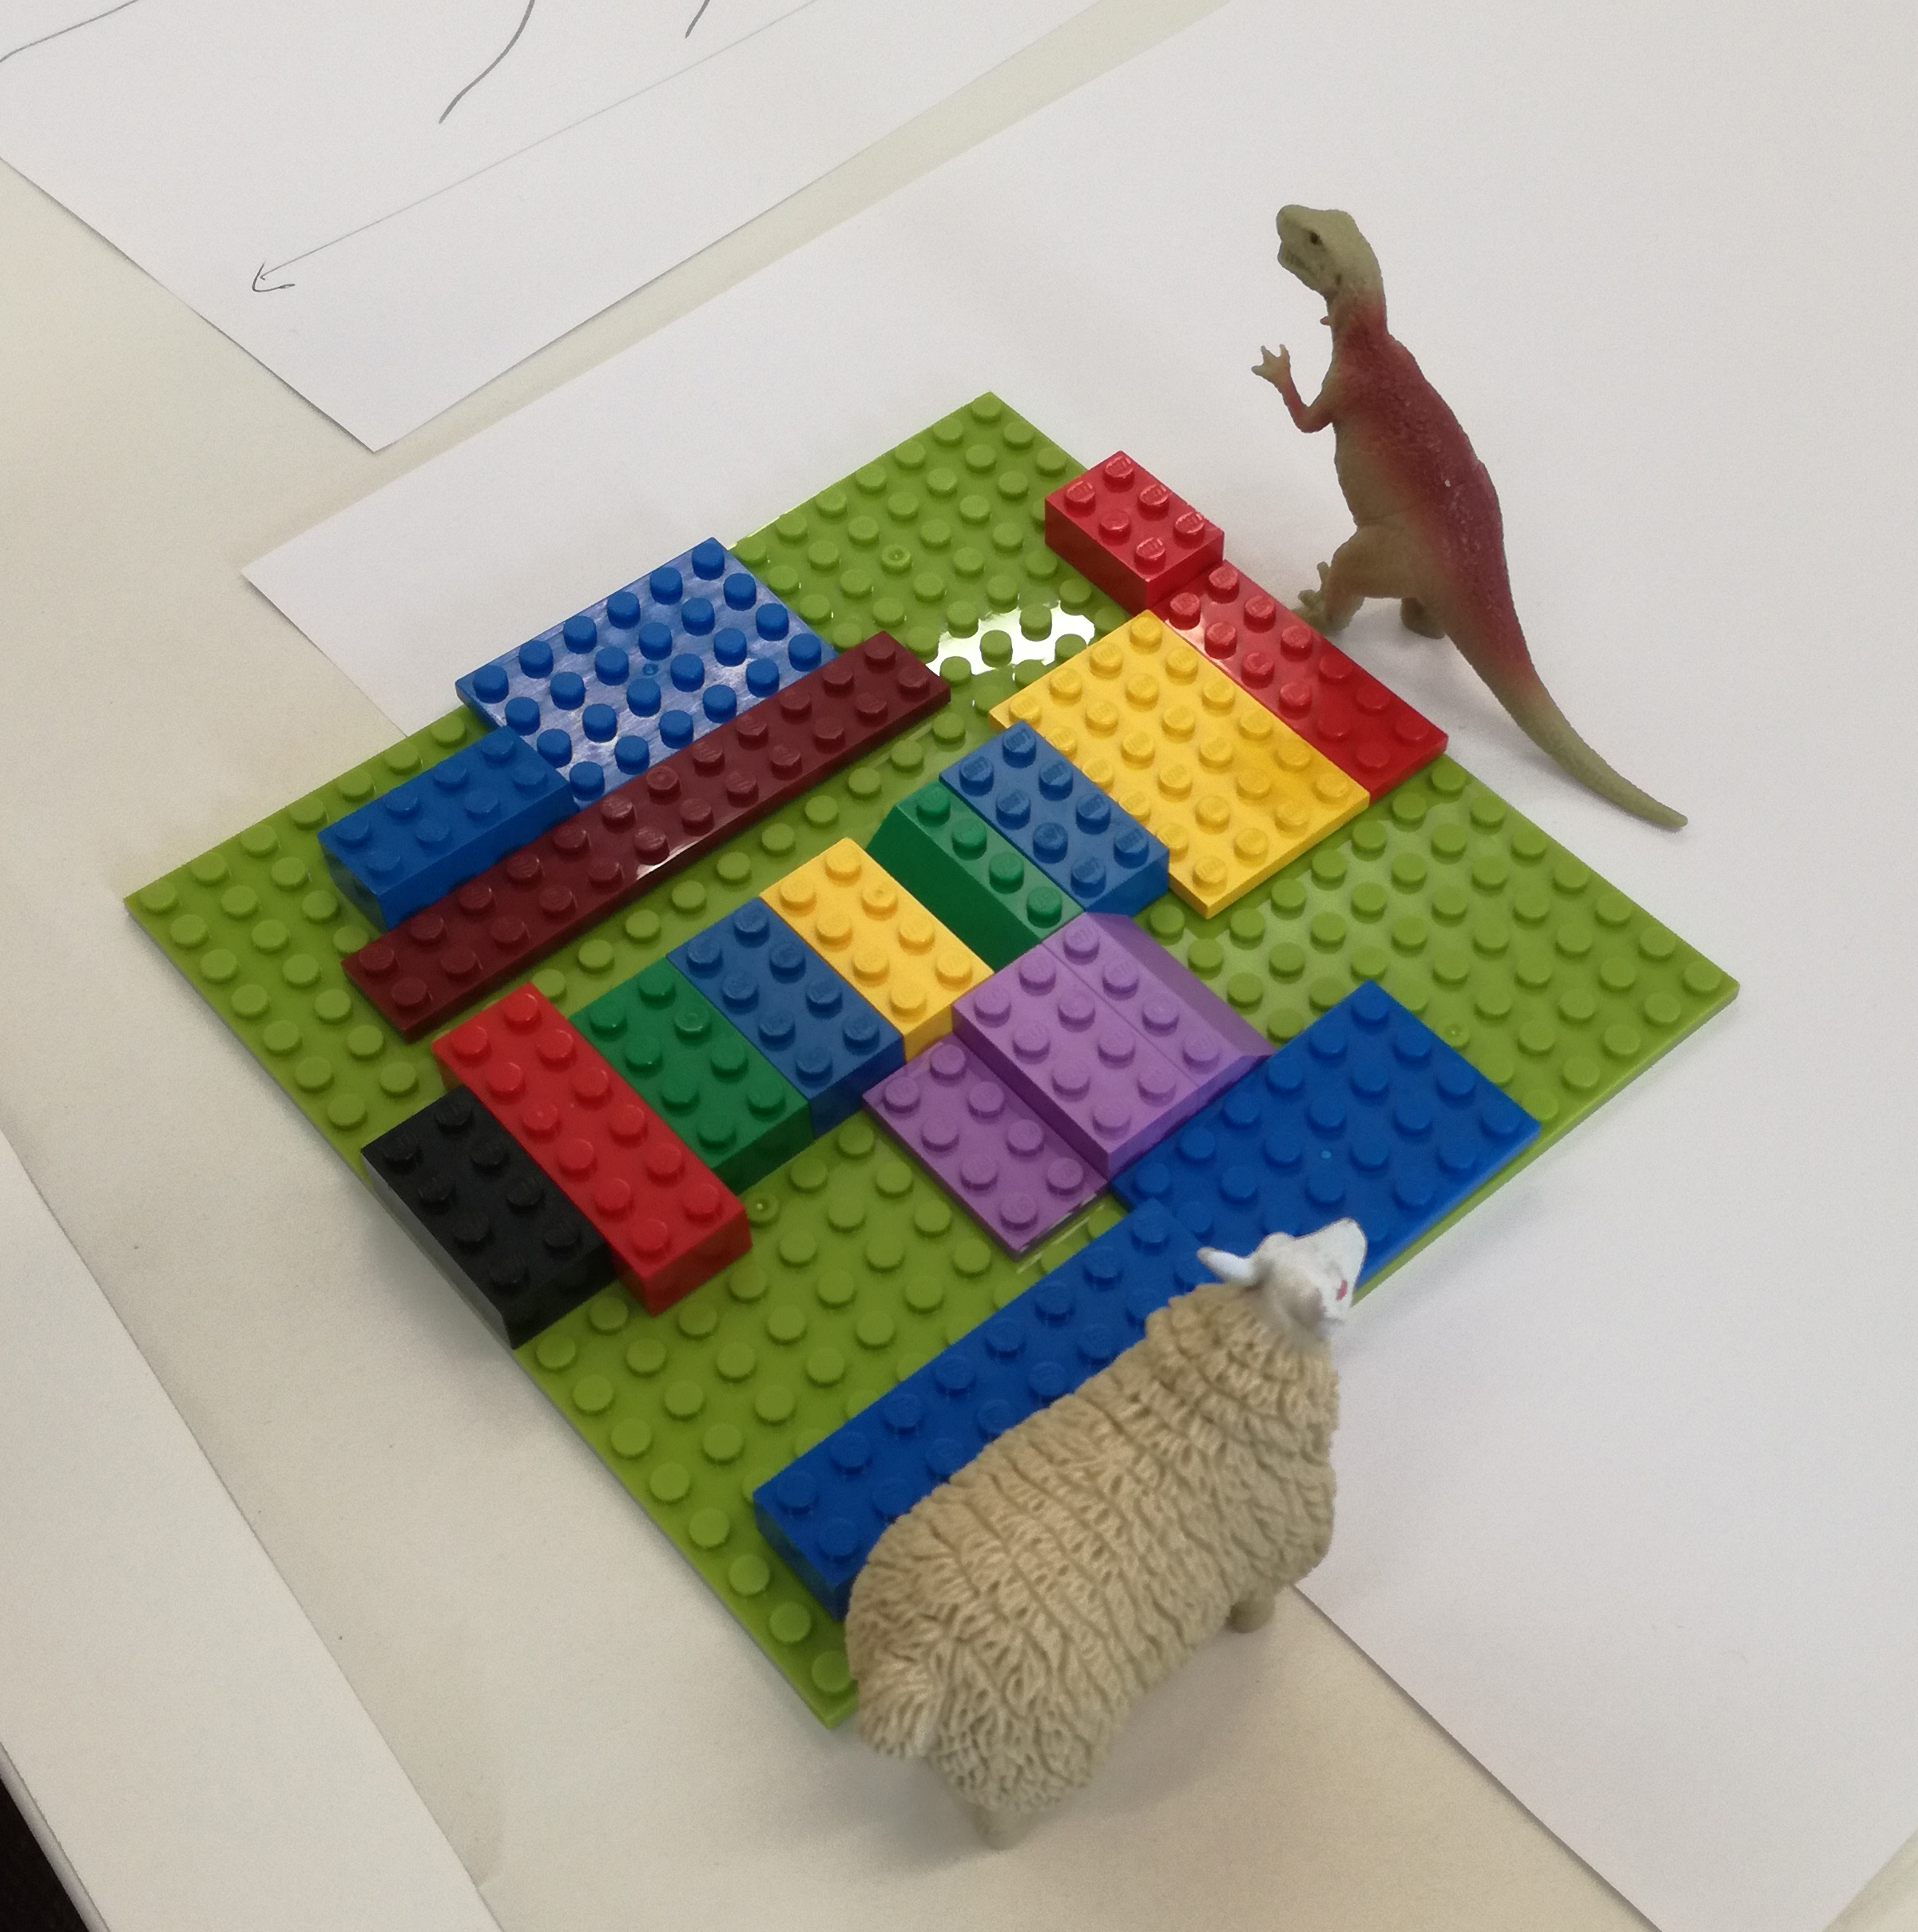

Slide 9
What is Well-being
Not the same as happiness
Not reducible to a mental state
“a dynamic state in which the individual is able to develop their potential” (National Accounts of Wellbeing (2009)
Not something that can be done to an individual!

Slide 10
What is Well-being?
POSITIVE EMOTION
ENGAGEMENT
RELATIONSHIPS
MEANING
ACHIEVEMENT
These “measurable elements, each a real thing, each contribute[...] to wellbeing, but none defin[es] wellbeing” (Seligman, Flourish)

Slide 11
What is Well-being? Juniper et al’s 7 factors
Juniper et al’s study of PhD students identified the following factors impacting on researchers’ wellbeing:
Development
Home and Health
Facilities
University
Supervisor
Social
Research

Slide 12
Student Support at the University of Kent
PhD student
Careers and EmployabilityService
Graduate School
Alumni mentoring scheme
Students’ Union and KGSA
School Reps
Supervisor
Office for Scholarly Communication
Postgraduate Administrator/ Student Experience Officer
Student Support and Well-being
Notes:
Slide 5 – What are the benefits of a doctoral community?
Employability and Transferable Skills – activities outside their home schools and centres provide students with a greater range of skills in support of their career advancement.
Support – access to a greater range of support mechanisms and individuals as potential sounding boards for the support and development of their doctoral research.
Inter-disciplinarity – students and staff members working indifferent disciplines bring an alternative and new perspective on the work of research students.
Well-being – the student/supervisory team relationship can be intensive and opportunities to network outside the home school (e.g. at research cafes, kick-start workshops and research festival) can provide a safe and more neutral environment in which to discuss concerns.
Monitoring and feedback – the interaction of doctoral students outside their academic schools also enables the Graduate School to obtain more direct feedback on their postgraduate experiences via the events, activities and doctoral student engagement with the Researcher Development Programme.
Completion – support and training to support PhD completion. The other side of the argument could be, do all these opportunities distract from the core goal of completing the thesis in good time?

Slide 13
From Carter and Laurs, Developing Generic Support for Doctoral Students, 153
Carter and Laurs

Slide 14

Graduate School support for PhD students:
Workshops: Mindfulness/Dealing with Stress/Giving and Receiving Feedback/Procrastination/Imposter Syndrome/Supervisor training
Events: Research Café, Postgraduate Festival and Wellbeing Week, Yoga and Writing Retreats, Shut up and Write
Competitions: Postgraduate Experience Awards

Slide 15
Metaphor
“Picturing a concept activates the visual cortex in the occipital lobe, at the back of the brain. This region can be activated through actual pictures, or thorough metaphors, and storytelling, anything that generates an image in mind. [...V]isuals are so useful [...because] they are highly information-efficient constructs. [...V]isual processes evolved over millions of years, so the machinery is highly efficient, especially in comparison to the circuitry involved in language.” David Rock, Your Brain at Work, p. 14

Slide 16
Metaphor
“[B]ecause metaphors embody “something vague, unknown and hidden,” they give form to the inexpressible. Because they make use of everyday concrete things to illustrate the intangible, complex and relationship aspects of life, they are vivid and memorable. And because of isomorphism*, only the essence of an experience needs to be captured; the rest can be reconstructed from inferential knowledge. (Lawley and Tompkins, Metaphors in Mind, loc. 289)
*metaphors represent something in terms of something else

Slide 17
What does wellbeing look like to our workshop participants?
“The workshop has been useful in allowing us to see that persistence and an embrace-the-challenge mind-set are required to all that embark in [PhD] this journey.”
“Listening to the other students was fascinating and moving and I valued the opportunity to share my own thoughts. [...] The effect of the workshop is the encouragement its given me and the opportunity to hear other stories.”

Slide 18
Using creative methods to support PhD students’ well-being
Jo Collins
@pgdevadvisor
j.p.collins@kent.ac.uk
Nicole Brown
@ncjbrown
www.nicole-brown.co.uk
nicole.brown@ucl.ac.uk

